Slide 1
Integrating
Research +
Education

Slide 2
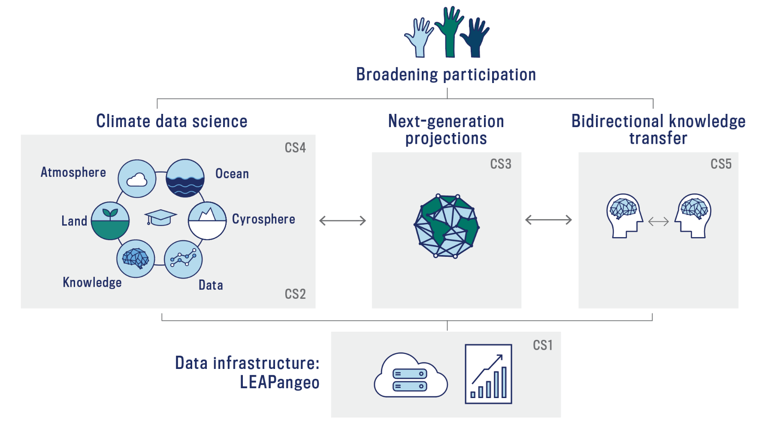
Our Roadmap
LEAP forward in the accuracy, utility, and reach of climate projections through synergistic innovations in data science and climate science.

Slide 3
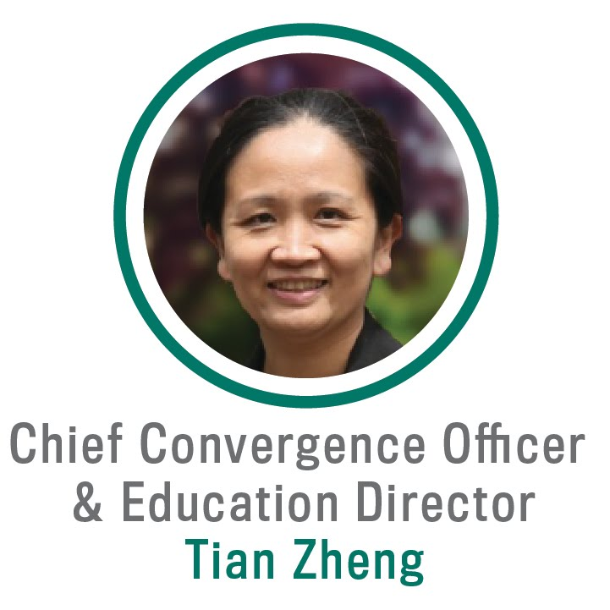
Professor + Chair of Statistics, Columbia
PhD, Statistics, Columbia
Expertise
  Spatiotemporal modeling
  Statistical machine learning
  Data science education
  Management
Synergistic Experiences
  Associate Director for Education,
  Data Science Institute, 2017-2020
  Creator, DSI Scholars Program, 2018-2020
  Leadership Team Member, Collaboratory Program
  Faculty Advisor, Columbia Statistics Club 2016-2020

Slide 4
My Presentation Will Explain:
Integration of research + education
Innovation of educational activities
How education contributes to LEAP’s unified mission
How evaluation allows correction + development

Slide 5
Climate Scientists + Data Scientists Face Collaboration Barriers
Disconnect between core disciplines exacerbates skills gaps + narrows pathways for convergent learning + research
Climate Science Research
Limited
Collaboration
Data Science Research
Climate Science Skills
Data Science
Skills
Climate Science
Core Competencies
Data Science
Core Competencies
Climate Science
Literacy
Data Science
Literacy

Slide 6

Research + Education Integration Drives Convergence
Education
Research
Education for Research
  Relevant training for convergent research
Research for Education
  Meaningful convergent experiences embedded in education

Slide 7
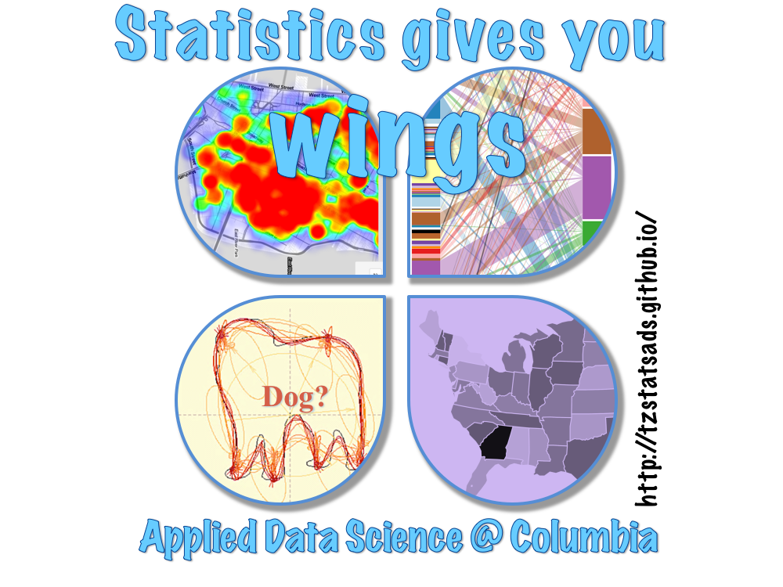
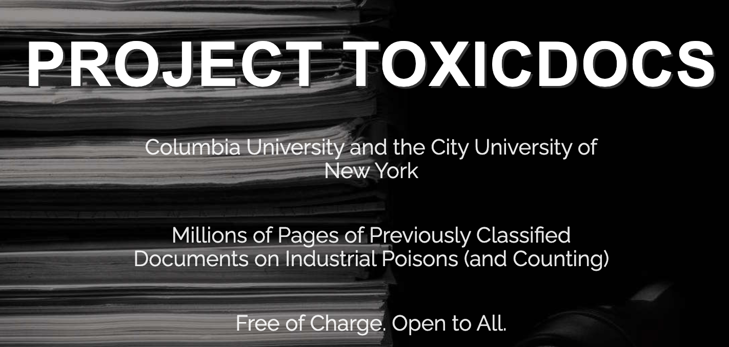
Research + Education Integration Drives Convergence
Education
Research
Applied Data Science:
A project-based learning course

Slide 8

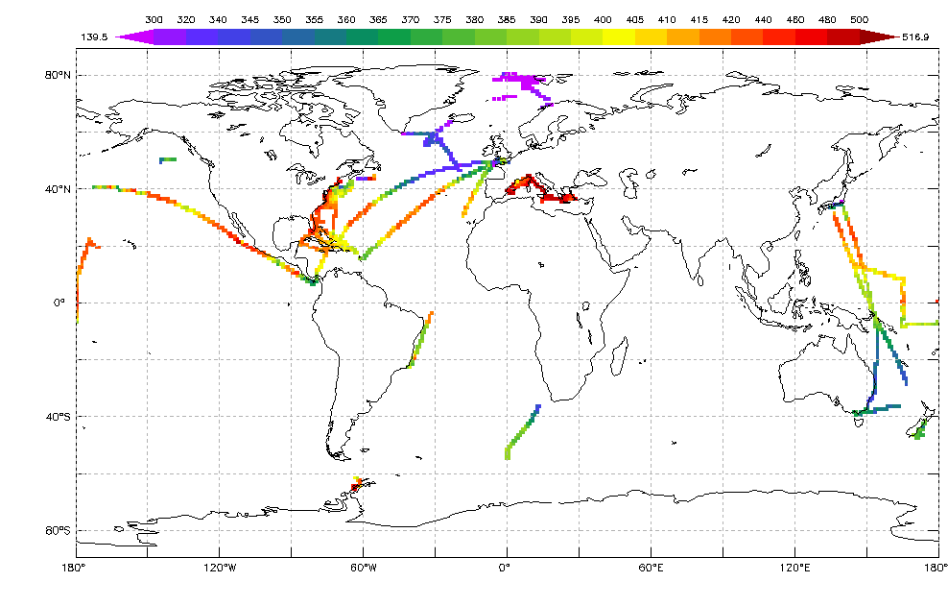
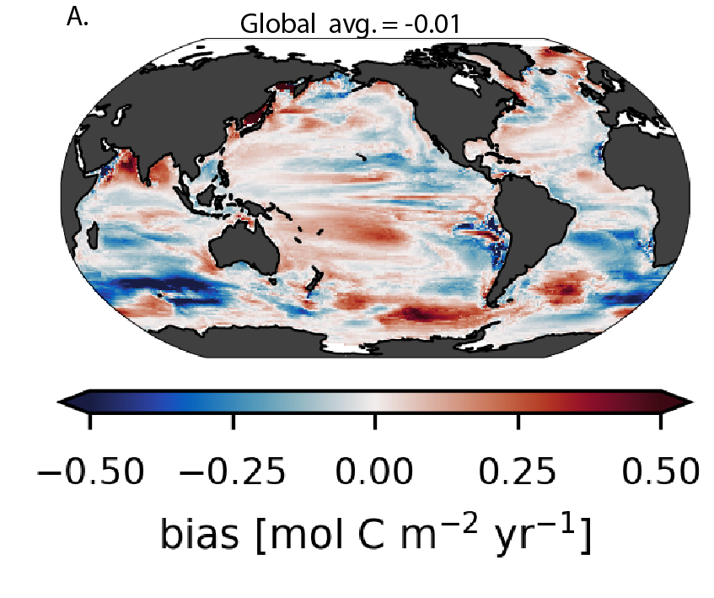
Research + Education Integration Drives Convergence
Education
Research
Data Science Capstone Project

Slide 9
Next-Generation Climate Data Scientists Will Create Broad Impacts
EO1: Develop research-intensive undergraduate + graduate curricula, providing multiple transdisciplinary entryways for students from diverse backgrounds + with varied career goals.
EO2: Offer immersive research experiences to student, teacher, parent + workforce trainees.
EO3: Broaden research impact through communication, translation, human-centered design, curriculum development, evaluation + assessment.

Slide 10
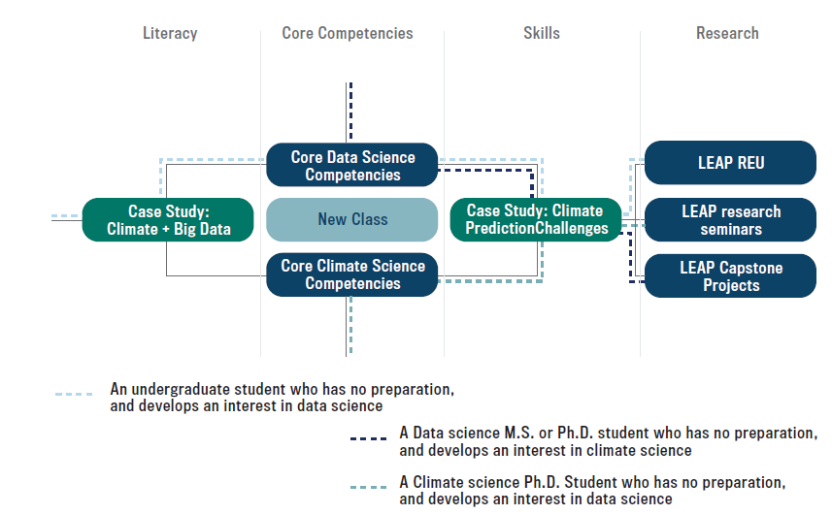
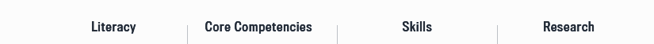
LEAP Creates a Climate Data Science Curriculum

Slide 11
A Graduate Certificate in Climate Data Science Reaches Diverse Trainees
LEAP Fellows
Graduate students at partner institutions
Graduate students affiliated with National Society of Black Engineers
Bridge programs participants
Online via Columbia Video Network
Columbia Business School’s executive education program
LEAP’s Storytellers in Residence

Slide 12
This Curriculum Offers Multiple Entry Points
Climate Science Graduate
Entry Point
Undergraduate
Entry Point
Introductory Courses for
Research Integration
Advanced Course for
Research Integration
Data Science Graduate
Entry Point

Slide 13
Research + Education is Integrated by Design
Education
Research
Course learning goals
Fixed timelines + deliverables
Limited instructional resources
Research goals
Risk + uncertainty
Needs for continuity + progress
Alignment of research goals + education goals
Design scaffolding for risk aversion
Additional support for class instructors
Results preservation + documentation
Teach researchers “human-centered design”
Design Studio
Course-
based Research Experience
“Train the Trainer” Faculty Workshops

Slide 14
Transdisciplinary Education Offers a Greater Quality + Quantity of Opportunities
Inclusive curriculum
Overcome barriers + embrace differences
Collaboration + open science
Fusing communities

Slide 15
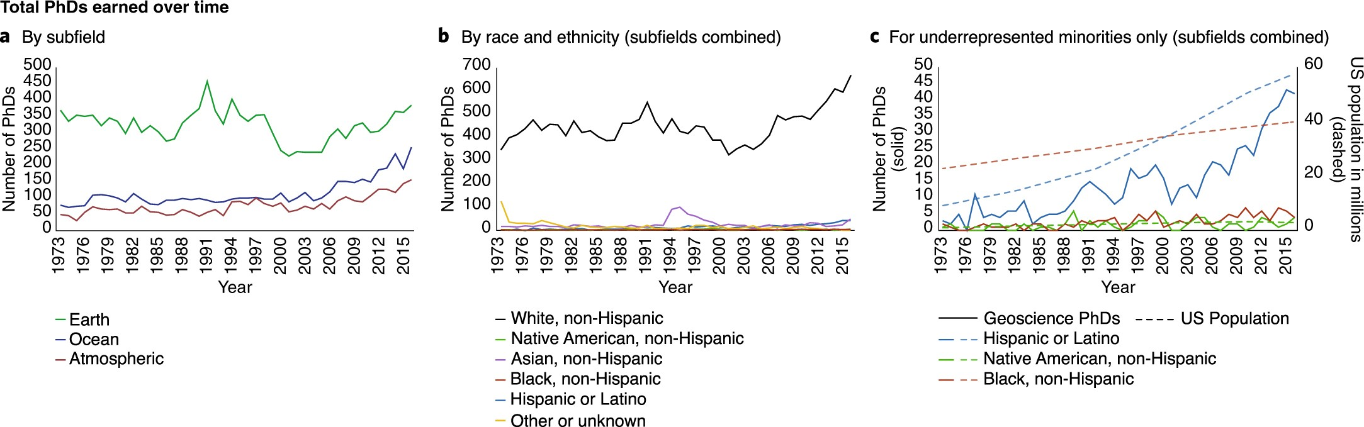
Climate Science is Not Diverse or Equitable + Has Not Changed
Bernard, Rachel E., and Emily HG Cooperdock. "No progress on diversity in 40 years." Nature Geoscience 11.5 (2018): 292-295.

Slide 16
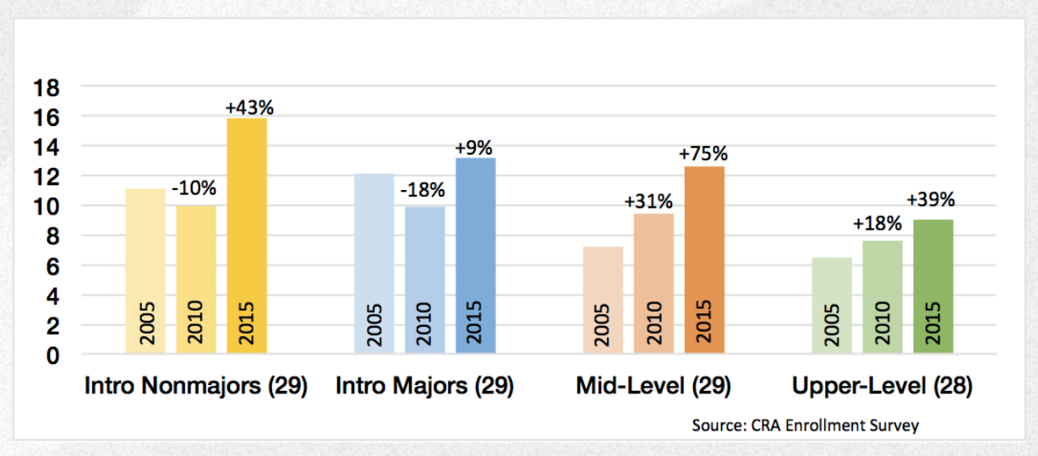
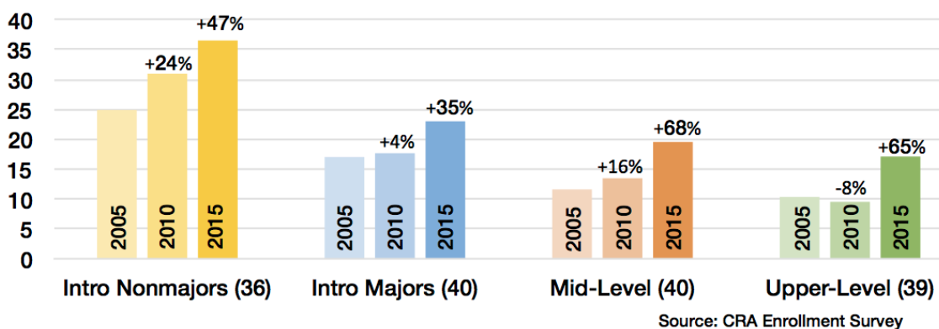
Data Science Curriculum has Improved but Still Poses Barriers
Women
Underrepresented Minorities
The Mixed News on Diversity + the Enrollment Surge
Computing Research Association (2015)

Slide 17
Next-Generation Climate Data Scientists Will Create Broad Impacts
EO1: Develop research-intensive undergraduate + graduate curricula, providing multiple transdisciplinary entryways for students from diverse backgrounds + with varied career goals.
EO2: Offer immersive research experiences to student, teacher, parent + workforce trainees.
EO3: Broaden research impact through communication, translation, human-centered design, curriculum development, evaluation + assessment.

Slide 18
Education Programs are Vertically Integrated
LEAP Research
LEAP Faculty + Postdocs
Seminar + Research
Doctoral Students
Summer Research
Interns Program
Course-Based
Research Experiences
Design Studio
Master’s + Undergraduates
Science Honors Program
High School Students
K-12 Teachers + Parents
“Lab to School” Program

Slide 19
LEAP Fellows Mentoring Plan
40 LEAP Fellowships across five year award
  Fellowships renewable based on progress + strategy
Faculty co-advising
Research Seminars: research skills, communication, reproducibility + data ethics
Climate Justice Leadership Board: leadership, program assessment + evaluation

Slide 20
Postdoc Mentoring Plan
7-8 postdocs per year at Columbia + Irvine
Faculty mentoring via bimonthly meetings
Onboarding self-assessment
Office of Postdoctoral Affairs
  Orientation
  Career exploration
  Job preparation + interview skills
  Publications + presentations

Slide 21
Next-Generation Climate Data Scientists Will Create Broad Impacts
EO1: Develop research-intensive undergraduate + graduate curricula, providing multiple transdisciplinary entryways for students from diverse backgrounds + with varied career goals.
EO2: Offer immersive research experiences to student, teacher, parent + workforce trainees.
EO3: Broaden research impact through communication, translation, human-centered design, curriculum development, evaluation + assessment.

Slide 22
LEAP Integrates Education, Broadening Participation + Knowledge Transfer
Bridge to PhD program
Climate Justice Leadership Board
Recruitment Experiment
Hackathon
SOARS Integration
Convergence Luncheons
Translate-a-Thons
Science Museum Partnership
Open-source Education Products
Education
Knowledge Transfer
Diversity, Equity + Inclusion

Slide 23
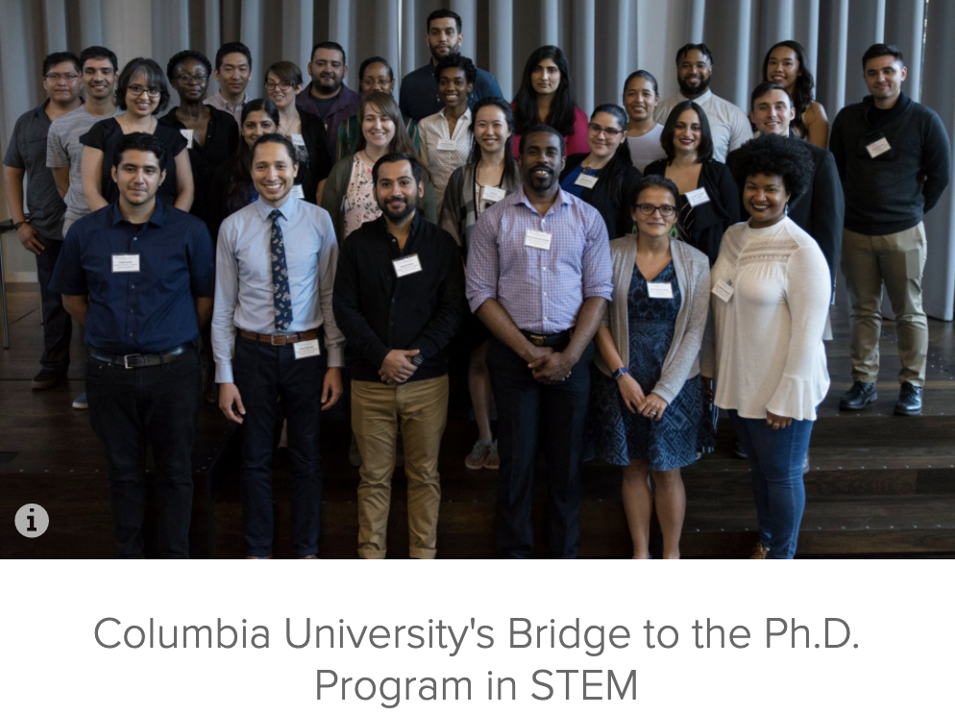

LEAP Partners with Established Diversity Bridge Programs to Extend Reach
Bridge to PhD Program
SOARS Integration

Slide 24
LEAP Delivers Open-Source Educational Products
Curricular materials + data sets
Formative assessment tools + rubrics
Designed course-based research experiences
“Train the trainer” workshop materials
“Lab to Schools” summer institute materials
  Translated into Spanish
LEAP’s Open-Source Commitment: Explained in Management + Administration presentation

Slide 25
LEAP Disseminates Convergent Educational Best Practices
Publishing in journals on climate science education + data science education
Present at professional conferences + meetings for academic leaders
“Lab to School” webinar series

Slide 26
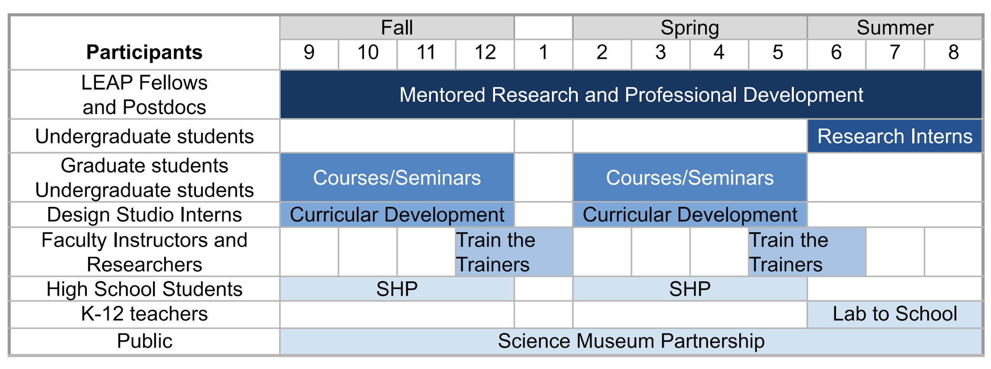
A LEAP Year in Education

Slide 27


























LEAP Leverages + Develops Existing Strengths

Slide 28


LEAP Leverages + Develops Existing Strengths
☑ Curriculum Development
Interdisciplinary Data Science Literacy
☑ K-12 Education

Slide 29


LEAP Leverages + Develops Existing Strengths
Online Collaboration
☑ Online Learning
Pangeo: Open-Source Big Data Climate Science Platform

Slide 30


LEAP Leverages + Develops Existing Strengths
☑ REU
☑ Bridge Programs
☑ High School Students

Slide 31
Implementation: Year 1
- Research + Course Development
YEAR 1
Open-Source Products
Data sets
Research products
Course-based REU designs
Offer Existing Courses in Core Competencies
Develop and Pilot New Course
Putting together proposal for Certificate for Professional Achievement in Climate Data Science

Slide 32
Implementation: Year 2
- Scale Up + Expand
YEAR 2
Open-Source Products
Data sets
Research products
Course-based REU designs
Course evaluation materials
Faculty + teacher training materials
Launch Certificate for Professional Achievement in Climate Data Science
LEAP and NYC
Bridge Programs

Slide 33
Implementation: Stable State
YEARS 3-5
Open-Source Products
Data sets
Research products
Course-based REU designs
Course evaluation materials
Faculty + teacher training materials
Launch Certificate for Professional Achievement in Climate Data Science
LEAP + NYC
Bridge to PHD
Online
SHP: Science Honors Program

Slide 34
Education Evaluation: Student Outcomes
Assessment Needs | Evaluation Methods
Knowledge + skills in climate data science | Assessment of the quality of Climate prediction challenges project products. Questions when approaching a new climate data science topic. Decision-making process.
Translational skills in climate data science | Evaluation of project reports on presentation, reproducibility, and ethics. Peer-reviews on teamworks. (Longitudinal) participation in the design studio and other LEAP activities as volunteers.
Career path | (Longitudinal) willingness to further their study in climate data science. (Longitudinal) willingness to apply for research internships. Career trajectory: LinkedIn profiles and follow-up surveys.
Design Studio learning outcomes | Performance on designing and supporting course-based research experiences. (Longitudinal) willingness to return to the design studio as a mentor.

Slide 35
Education Evaluation: Program Outcomes
Assessment Needs | Evaluation Methods
Education Success | Aggregated statistics on student performance Aggregated statistics on student participation Surveys + interviews of students’ learning experience
Research-Education Integration Success | Aggregated statistics on faculty participation Mentoring LEAP fellows + summer interns Submitting Design Studio proposals Participating in LEAP education activities Aggregated statistics on research products Aggregated statistics on student outcomes Surveys +interviews of faculty + students on research experiences
Community Engagement | Aggregated statistics on participation of faculty, postdocs + trainees in community engagement activities Survey for “Lab to School” participants: improved understanding of climate data science; willingness to adapt teaching units; parents’ support of climate curriculum Statistics of open-source education products

Slide 36
Formative Reviews + Course Correction
Student Outcomes
  Frequency: Once per semester
  Goal: Focus on outcomes contributing to convergence
  Distribution: Reviewed by Convergence Subcommittee
Program Outcomes
  Frequency: Once per year
  Goal: Determine program resource allocation
  Distribution: Shared in annual newsletter

Slide 37
Next-Generation Climate Data Scientists Will Create Broad Impacts
EO1: Develop research-intensive undergraduate + graduate curricula, providing multiple transdisciplinary entryways for students from diverse backgrounds + with varied career goals.
EO2: Offer immersive research experiences to student, teacher, parent + workforce trainees.
EO3: Broaden research impact through communication, translation, human-centered design, curriculum development, evaluation + assessment.

Slide 38
LEAP Aspires to Create a New Discipline:
Climate Data Science
6 Disciplinary Attributes * | LEAP’s Translation
Defined Object of Research | Data-Driven Parameterization + Projection in Atmosphere, Ocean, Land, Cryosphere
Accumulated Specialist Knowledge | Climate Science + Data Science
Organization + Integration | Knowledge-Data Continuum, Cross-Cutting Methods
Unique Terminologies + Language | Convergence + Stakeholder Engagement
Research Methods | Physics-Guided Machine Learning
Formal Teaching + Learning | Graduate + Undergraduate Educational Programs
* Source: Inside Higher Ed, 6 Attributes of an Academic Discipline
https://www.insidehighered.com/blogs/technology-and-learning/6-attributes-academic-discipline

Slide 39
Questions + Feedback?

