Slide 1
LEAPangeo:
Shared Experimental Facilities
Dr. Ryan Abernathey
Director of Data and Computing
Associate Professor of Earth and Environmental Sciences

Slide 2
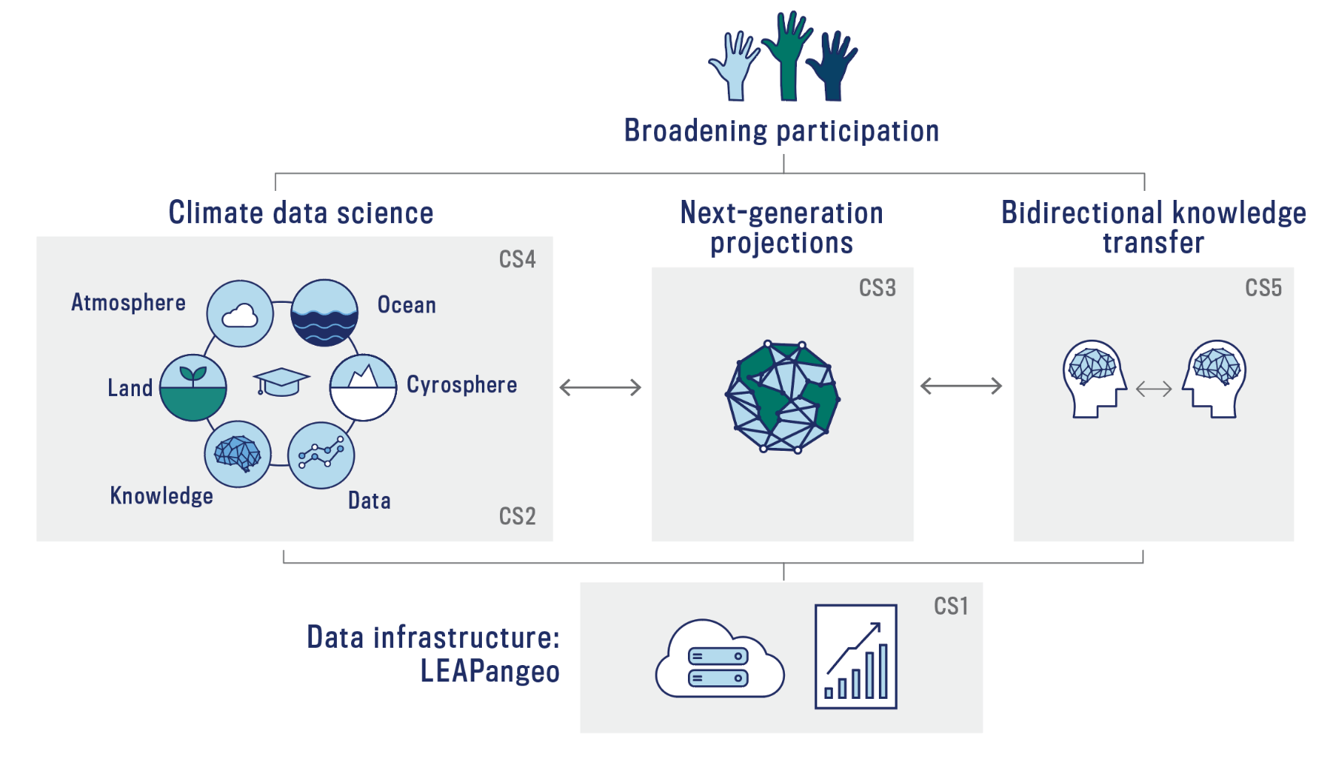
Our Roadmap

Slide 3
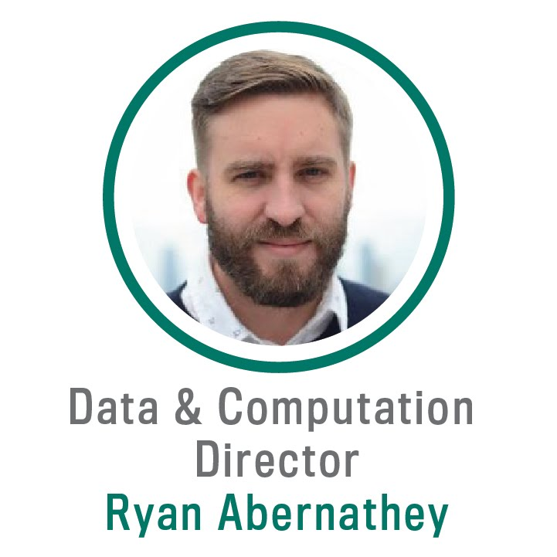
Associate Professor of Earth + Environmental Sciences, Columbia
PhD, Climate Physics + Chemistry, MIT
Expertise
  Ocean transport and mixing
  Ocean modeling
  Data analysis, visualization, cloud computing
Notable Experience
  NASA SWOT Science Team
  Lead PI, Pangeo (NSF EarthCube Project)

Slide 4
My Presentation Will Explain:
Why LEAPangeo—a shared data and computing platform—is needed to achieve LEAP’s goals
Architecture, development, and management of the platform
Integration of this platform with research, education, and knowledge transfer

Slide 5
Why is climate data hard?
  Size
  Complexity
  Geometry

Slide 6
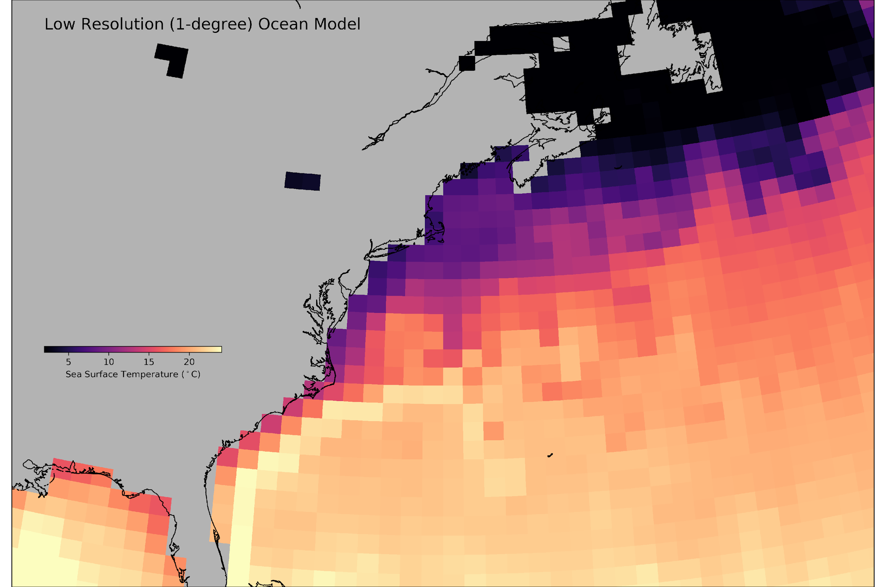
Why is climate data hard?

Slide 7
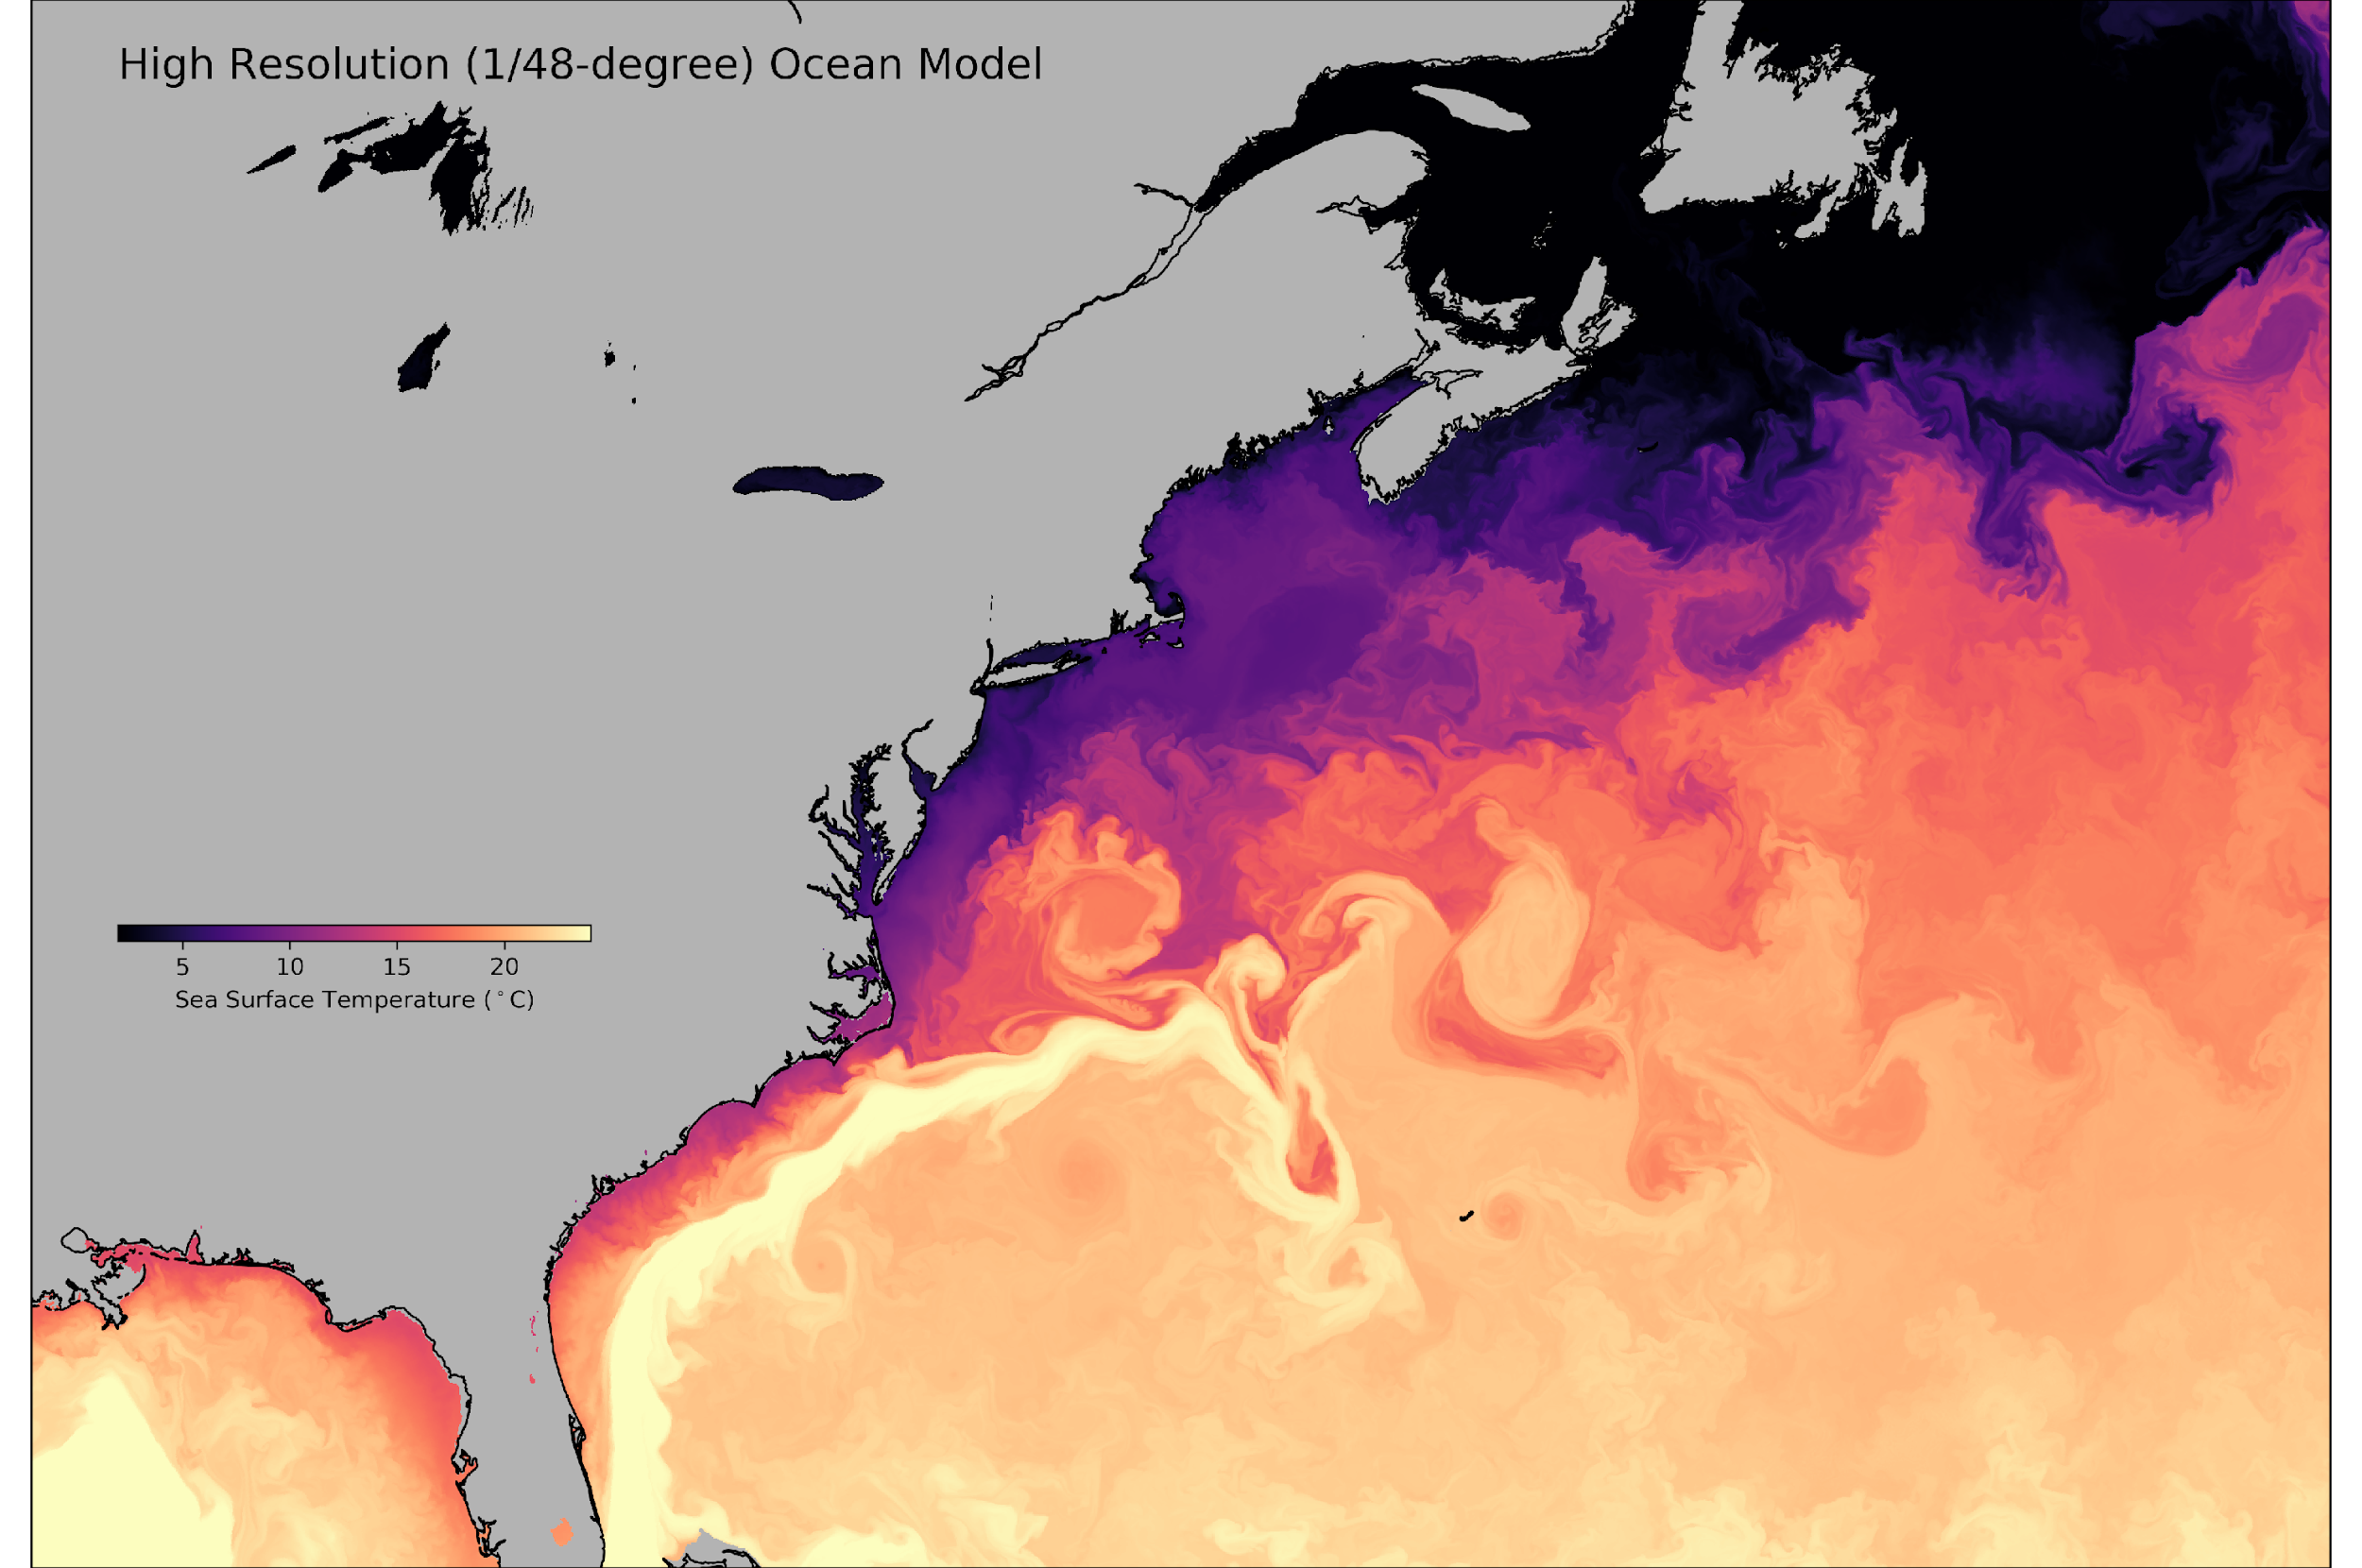
Why is climate data hard?

Slide 8
Why is climate data hard?
Time

Slide 9
Why is climate data hard?
Depth
  Size

Slide 10
Why is climate data hard?
Scenario A
Scenario B
Scenario C
Variable A
Variable B
Variable C
  Complexity

Slide 11
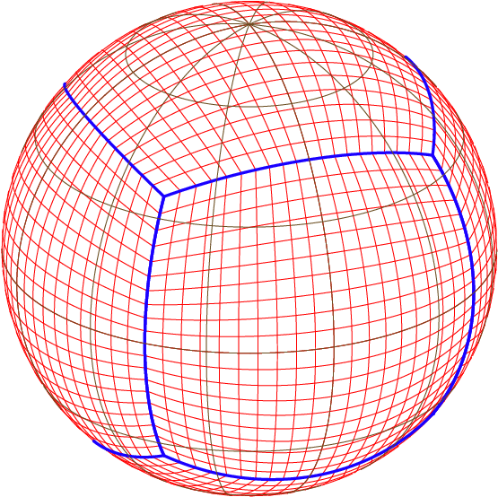
Why is climate data hard?
  Geometry

Slide 12
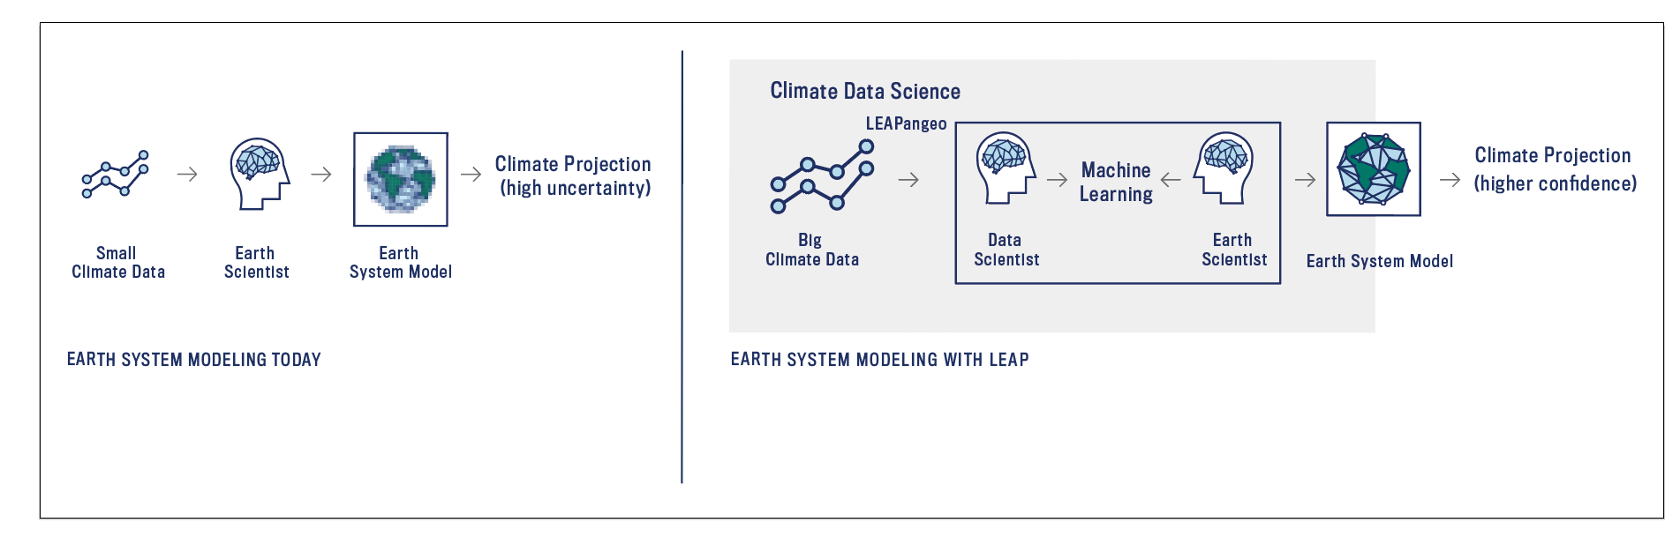
The Leap Data / Computing Challenge
Very large, complex datasets
Cutting-edge techniques / algorithms
Diverse group of participants (different disciplines / expertise levels)

Slide 13
The Leap Data / Computing Challenge
😖
Very large, complex datasets
Cutting-edge techniques / algorithms
Diverse group of participants (different disciplines / expertise levels)

Slide 14
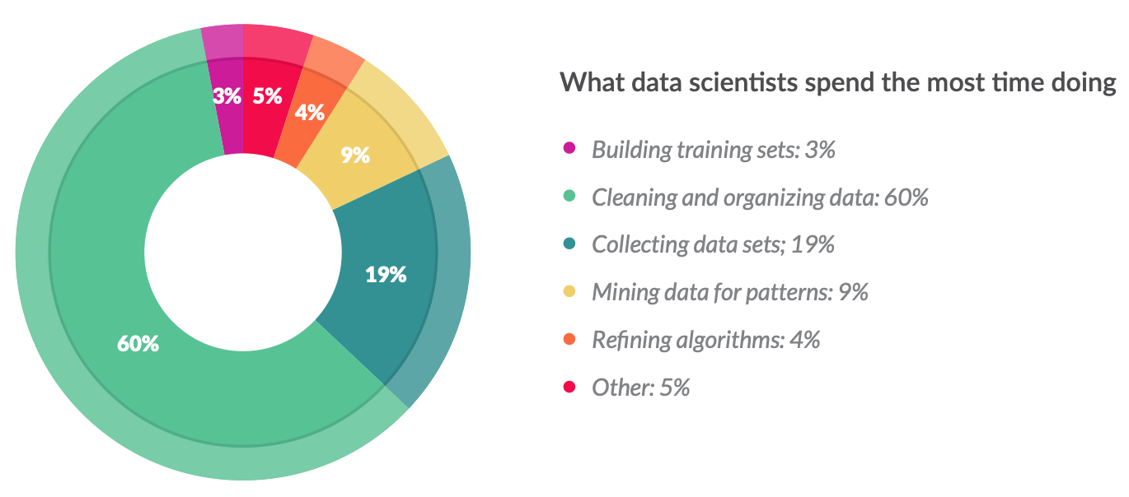
80/20 Rule of Data Science
How do data scientists spend their time?
Crowdflower Data Science Report (2016)

Slide 15
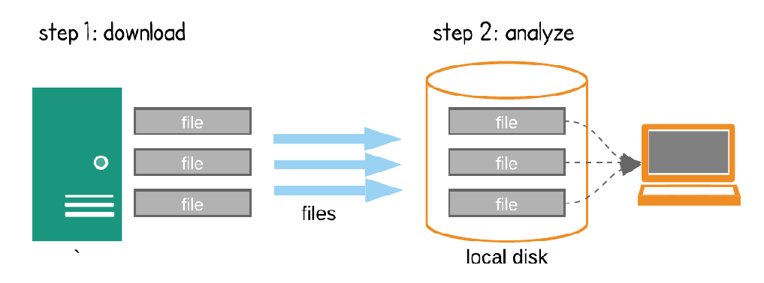
Status Quo in Data Science:
The “Download Model”

Slide 16
Status Quo in Data Science:
The “Download Model”
Not scalable
Not reproducible
Barrier to collaboration
Limits creativity
Inefficient / duplicative
Limits inclusion

Slide 17
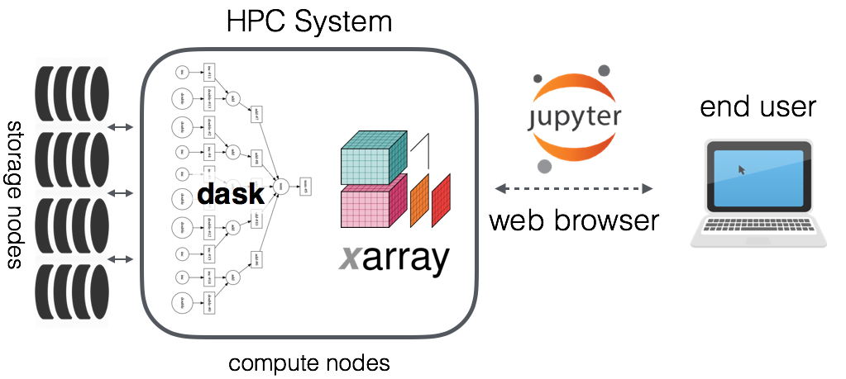





The Future of Data Science:
Data-Proximate Computing
On-demand scaling
Inherently reproducible
Highly collaborative
Unleashes creativity
Cost effective
Accessible to all
Cloud Compute Environment
compute node
compute node
Object Storage
compute node
compute node

Slide 18






















A Community Platform for Big-Data Geoscience
http://pangeo.io/
Founded at Columbia in 2016
Grass-roots collaboration between scientists, software developers around open-source tools for solving real problems
Supported by NSF EarthCube,
NASA ACCESS
International partners,
industry connections

Slide 19



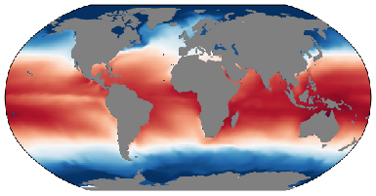





: Open Source, Community Development
open-source software libraries
scientific users / use cases
👩🏾‍💻
Agile development
Contribute widely the the open source scientific python ecosystem
Maintain / extend existing libraries, start new ones reluctantly
Solve integration challenges
Define science questions
Use software / infrastructure
Identify bugs / bottlenecks
Provide feedback to developers
HPC and cloud infrastructure
Deploy interactive analysis environments
Curate analysis-ready datasets
Platform agnostic

Slide 20

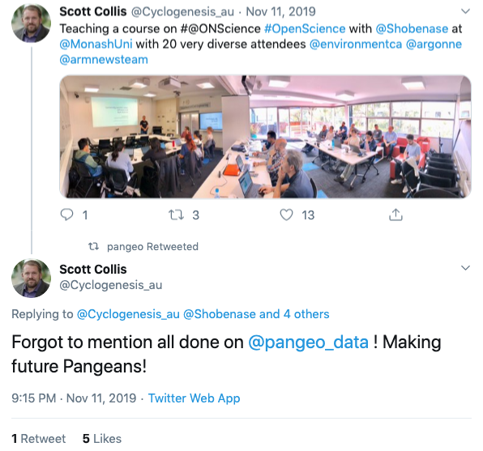

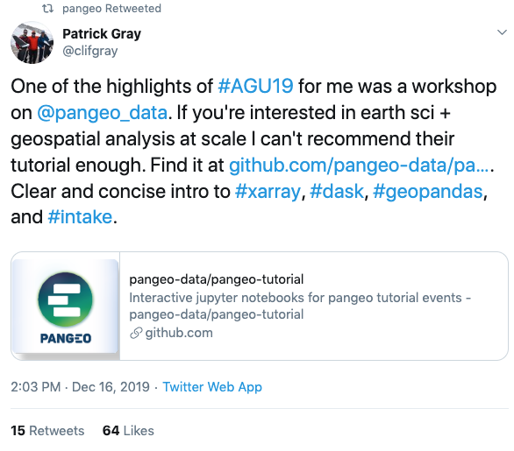


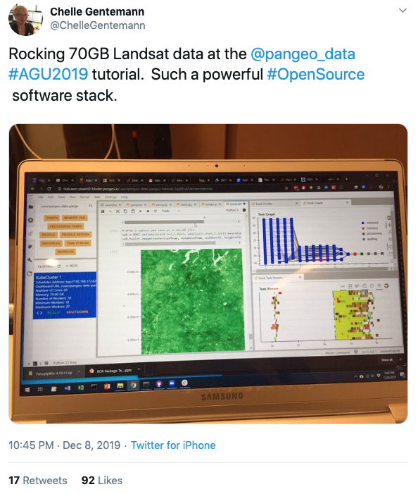
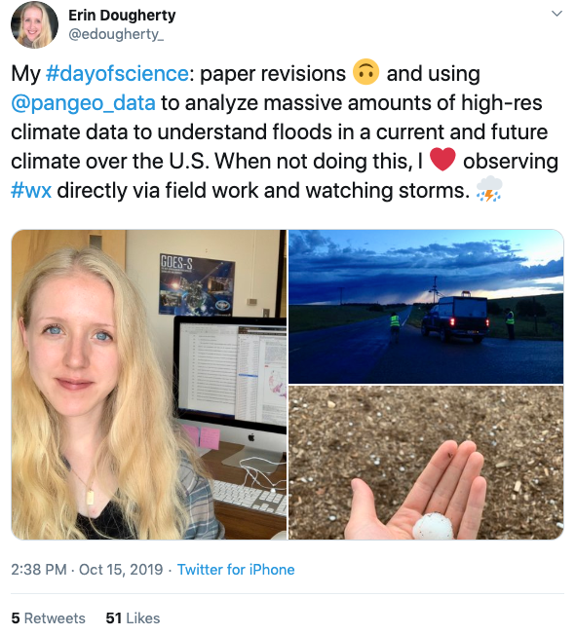


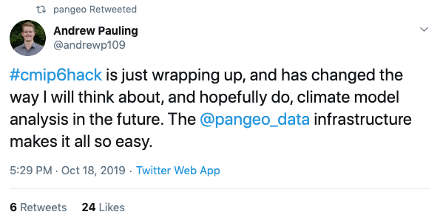
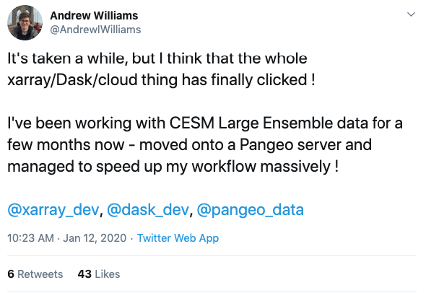
: Real Scientists, Real Impacts

Slide 21

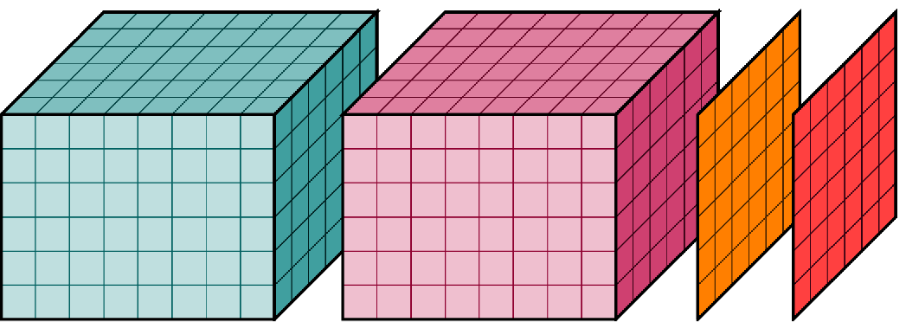

+ = LEAPangeo
collaboration platform for the LEAP project
👩🏾‍💻👨🏻‍💻👩🏽‍💻
Scientists
Educators
Students
Partners
Data Library
Compute Environment
Cloud object storage
Cloud computing

Slide 22
LEAPangeo Architecture is Open and Modular
Data Library
Compute Environment
Cloud object storage
Cloud computing
Analysis ready data, optimized for ease of access and computing
Used to train / validate ML models
Hosted by cloud providers: fully public datasets accessible to the world
Impact: lower the barriers to working with climate data
Uniform software environments for all collaborators w/ latest ML tools
Access to ML-optimized hardware (e.g. GPUs, TPUs)
Impact: enhance collaboration and facilitate reproducibility

Slide 23
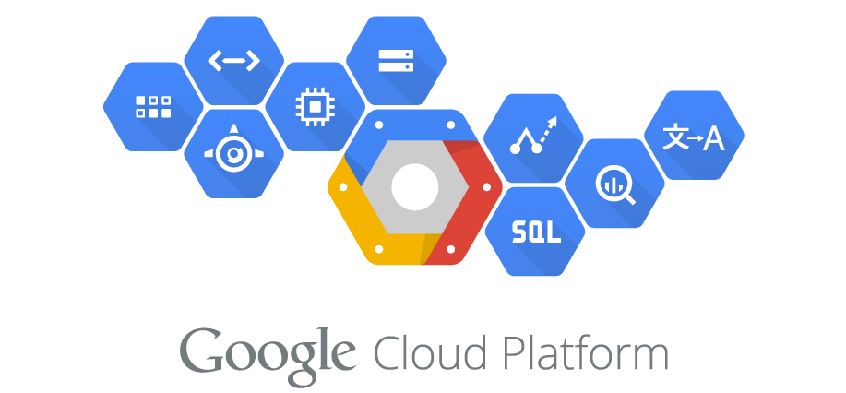

Cloud + HPC: Complementary Tools
Commercial Cloud
Traditional HPC
Data flow
Used to run large-scale simulations
Generate training data
(high-res simulations)
Test parameterizations online in CESM
Restricted access to data and compute
Used for interactive data analysis
Analyze data / train models
Collaborate with industry ML teams
Open access

Slide 24
LEAPangeo Supports Education and Research
Interdisciplinary Research Teams
Education
👩🏾‍💻👨🏻‍💻👩🏽‍💻
👩🏾‍💻👨🏻‍💻👩🏽‍💻
fluid collaboration
Graduate seminar
Convection
👩🏾‍💻👨🏻‍💻👩🏽‍💻
👩🏾‍💻👨🏻‍💻👩🏽‍💻
👩🏾‍💻👨🏻‍💻👩🏽‍💻
👩🏾‍💻👨🏻‍💻👩🏽‍💻
SOARS participants
Hackathon participants
Biological pump
Ice sheet dynamics
Data Library
Compute Environment
Cloud object storage
Cloud computing

Slide 25
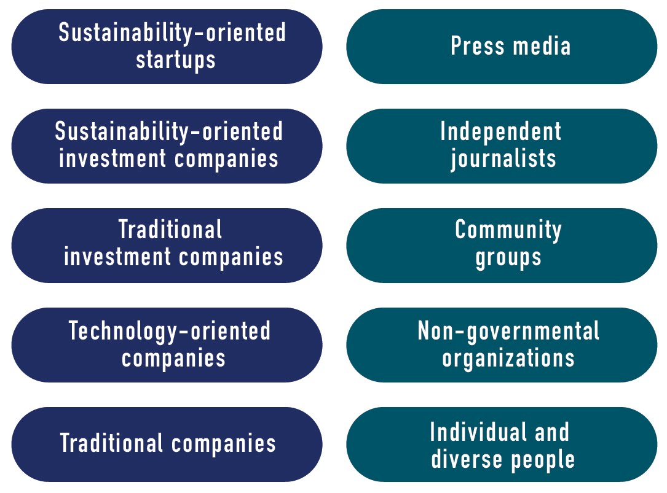

LEAPangeo Enables Knowledge Transfer
LEAP Climate
Information Portal
Data Library
Compute Environment
Cloud object storage
Cloud computing

Slide 26
Management for Success
Two FT engineers at Columbia:
data library + compute environment
Open development / Agile approach
➡️ low risk, immediate impact
Contribution to upstream open-source libraries
➡️ sustainability and broader impacts across NSF research
Partnership w/ Google + Microsoft:
Cloud computing credits, joint development
Bi-annual training bootcamps for all participants

Slide 27
LEAPangeo is Sustainable
Underlying software is 100% open source and modular
Implementation is cloud agnostic: no lock-in
Data can be moved between commercial cloud, traditional HPC, and emerging platforms (e.g. NSF OpenStorageNetwork)
Wide range of government and industry partners

Slide 28
LEAPangeo will transform science!
Enable the ambitious LEAP research / education / knowledge-transfer goals.
Transform infrastructure for collaboration in Data Science.

