Slide 1
Management + Administration

Slide 2
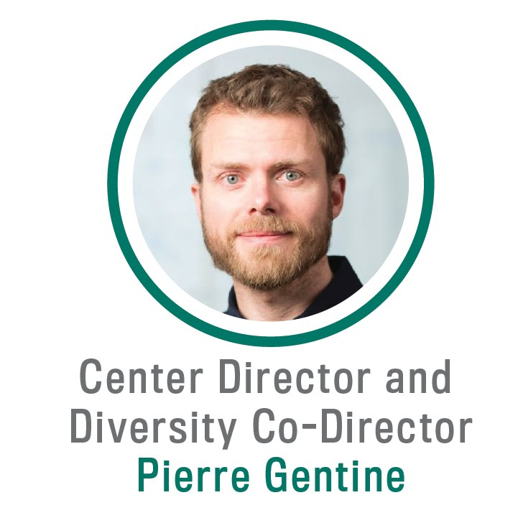

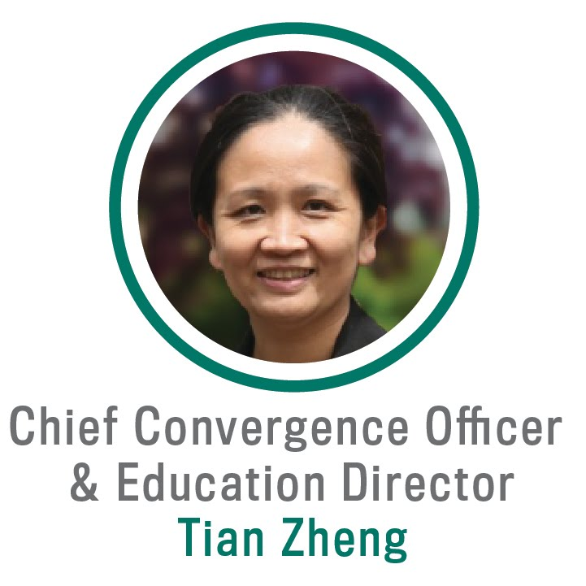
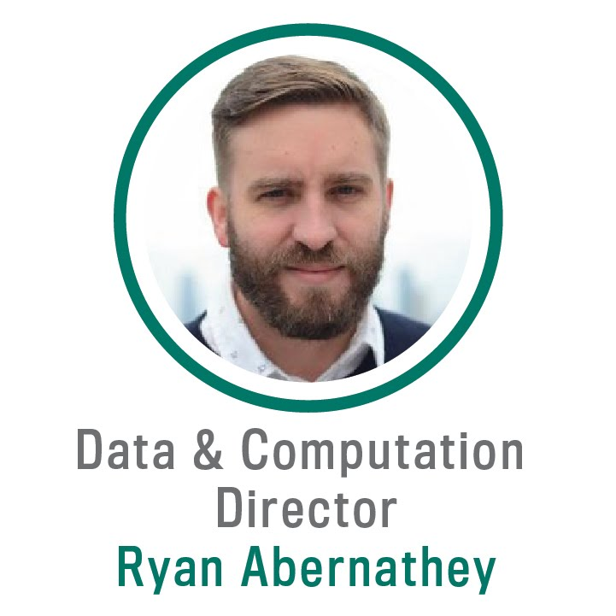
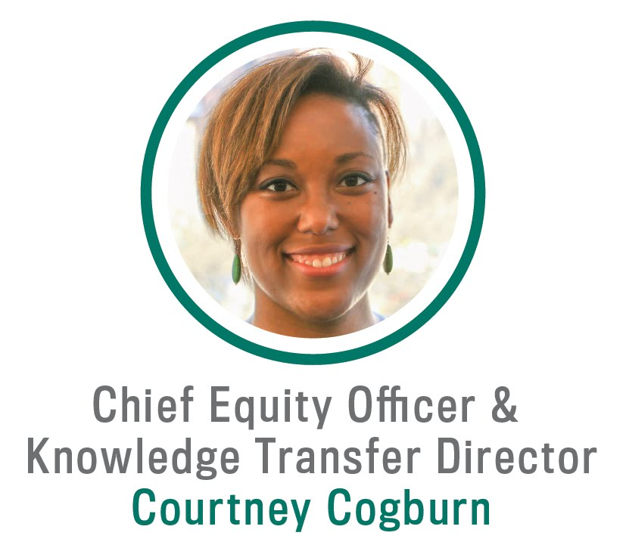
LEAP PI + Co-PI team

Slide 3
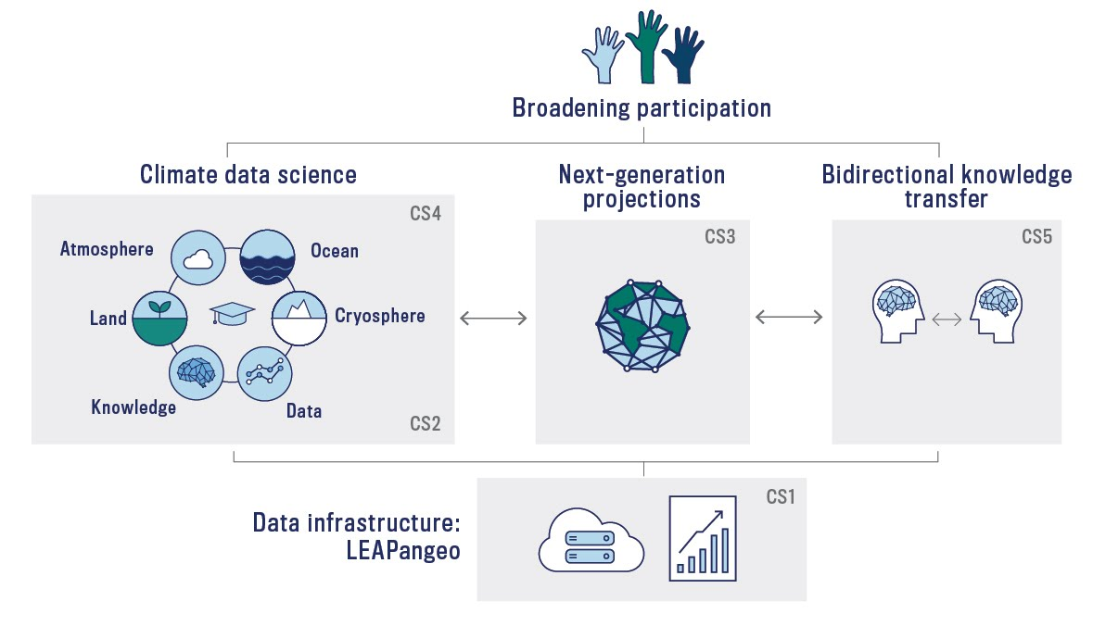
Implementing our vision
LEAP forward in the reliability, utility, and reach of climate projections through synergistic innovations in data science and climate science.

Slide 4




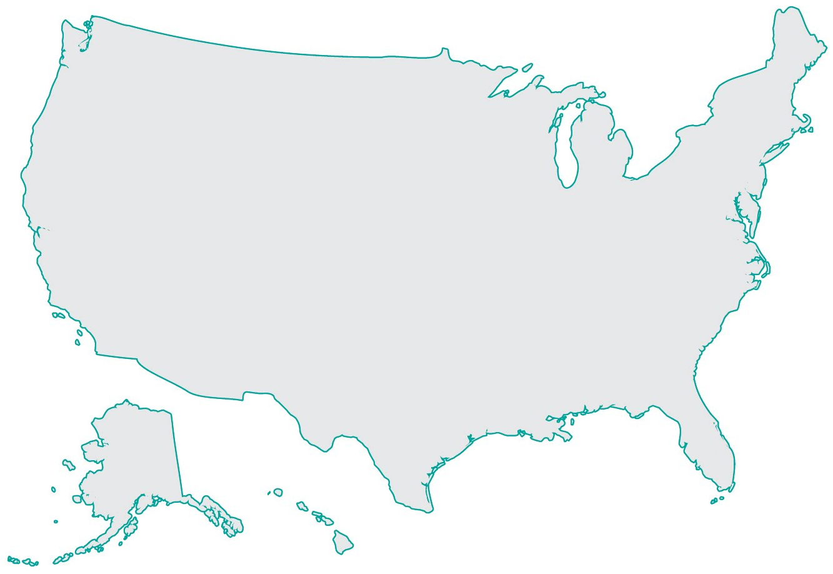

























LEAP spans the continent, with NYC as hub

Slide 5
Complementary university capabilities integrated through structured programs
University | Expertise
Columbia | Climate science, data science, psychology, management, education, communications → build on transdisciplinary culture
NYU | Machine learning for ocean modeling
UC Irvine | Computational atmospheric physics
Minnesota | Physics-guided machine learning
Montreal (MILA) | Machine learning applications to climate change
Teachers College | Environmental education, education policy

Slide 6
Values inform LEAP’s management approach
Transparent, shared governance to leverage broad expertise
Proactive steps for diversity, equity + inclusion
Research structured to ensure impact on climate projections
Open-source
Bi-directional knowledge transfer to continually engage stakeholders
“This is a large complex project that needs to be managed well to be exceptionally successful.” - NSF Panel Summary

Slide 7
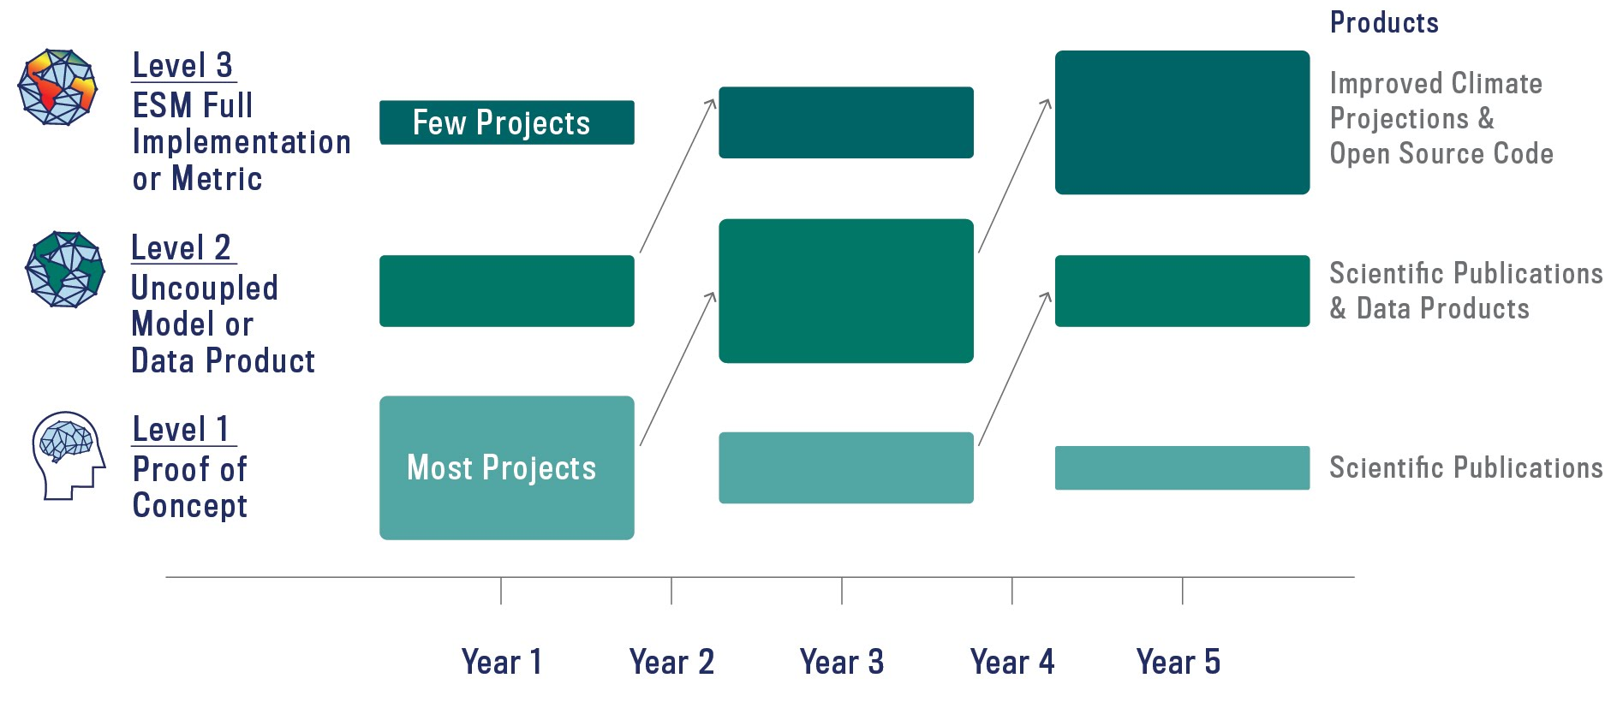
Research strategy will move projects from Proof of Concept to ESM Implementation

Slide 8
LEAP is 100% Open-Source
Goal | Vehicle
Shared Data | LEAPangeo, Website
Shared Code | GitHub
Shared Ownership, Transparent Operations | Operations Manual, Annual Report, Newsletter
Transparent Funding Decisions | Funding Review Panel, Ethics Handbook, Website
All innovations publicly disclosed
  Open licensing → inclusive, broadening participation, and knowledge transfer
  Published as soon as possible
  Underlying code published to website
Consistent with NCAR’s CESM + NSF’s Pangeo open-source models

Slide 9
LEAP is well positioned for virtual work
Mainly computational research
LEAPangeo provides cloud-based distributed data infrastructure
Team highly-experienced in virtual meetings + distanced collaboration
Will continue to adapt with emerging technology
This Site Visit showcases team ability to work effectively at a distance

Slide 10
Governance structure implements Vision through the 5 Convergence Strategies
CS4: Equitably + inclusively train climate data scientists
CS2: Create next-generation algorithms
CS5: Establish bidirectional knowledge transfer
CS3: Develop
next generation CESM
CS1: Revolutionize geoscience data infrastructure

Slide 11
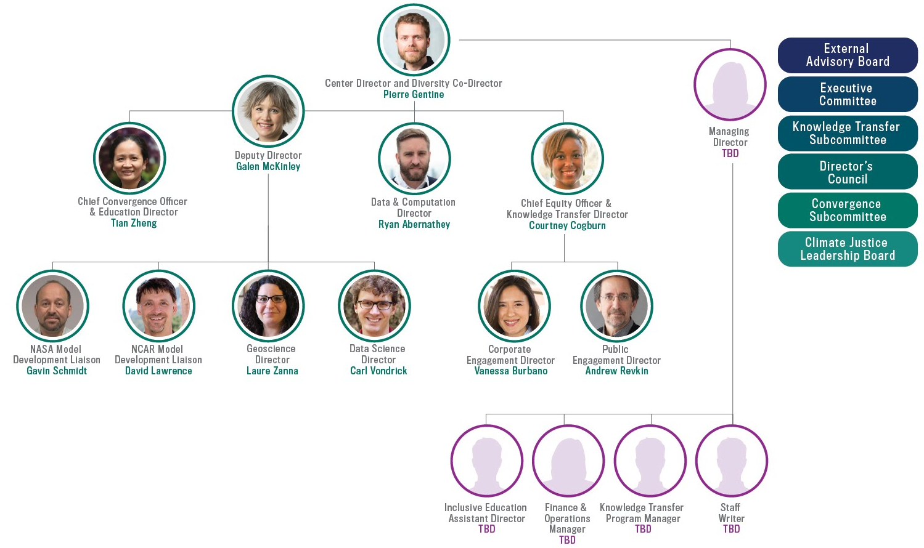
LEAP governance is shared + distributed

Slide 12
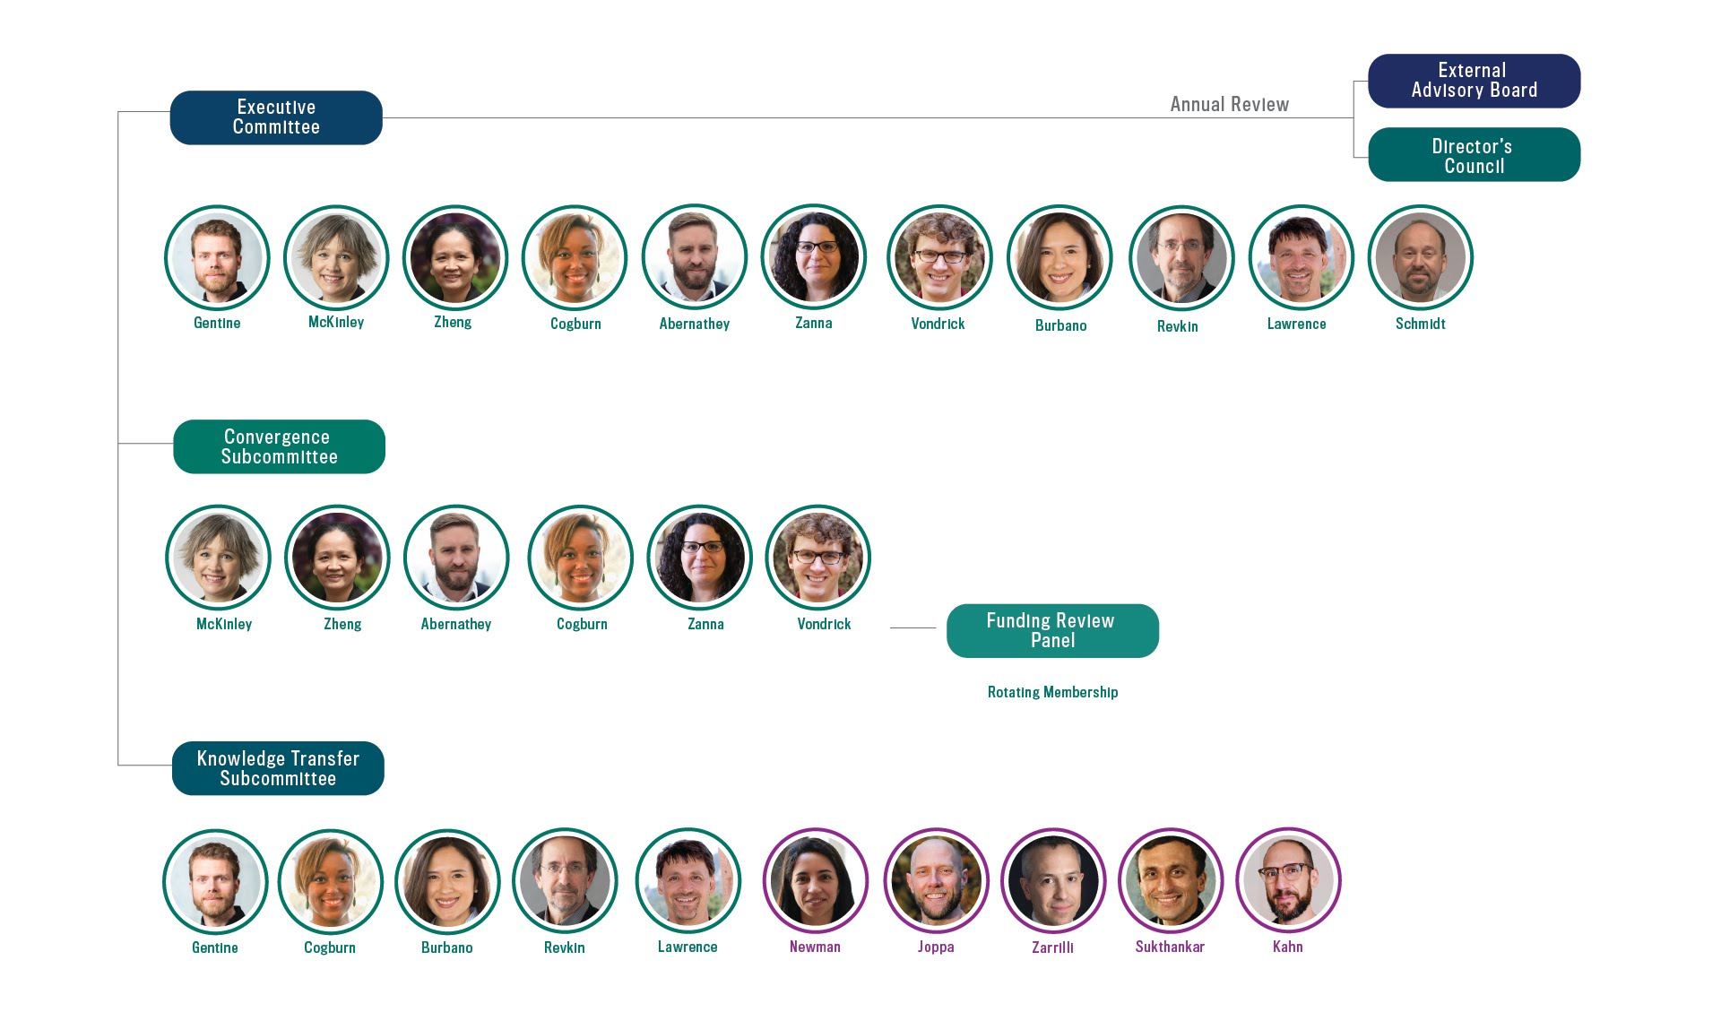
LEAP Governance Committees

Slide 13
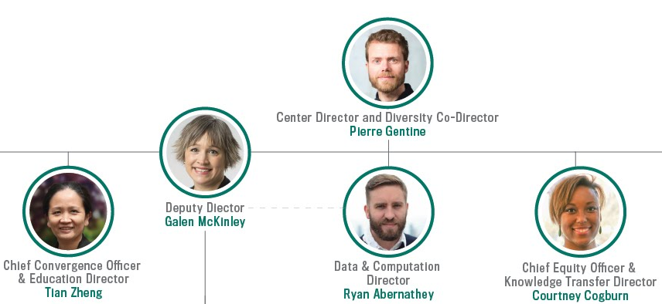
Director’s Responsibilities
Center Director + Diversity Co-Director Gentine
Chairs Executive Committee
Liaises with NSF + Partners
Co-Leads Broadening Participation Programs
Insures Integration of all Convergence Strategies (CS)

Slide 14
Deputy Director’s Responsibilities
Deputy Director McKinley
Coordinates Research Activities
Ensures Research + Education Integration
Co-Chairs Convergence Subcommittee
Supervises CS2 (algorithms) + CS3 (CESM)

Slide 15
Chief Convergence Officer + Education Director Responsibilities
Chief Convergence Officer + Education Director Zheng
Oversees All Educational Programs
Supervises Evaluation
Co-Chairs Convergence Subcommittee
Co-Supervises CS4 (training + broader impacts) with Cogburn

Slide 16
Data + Computation Director’s Responsibilities
Data + Computation Director Abernathey
Oversees LEAPangeo
Supervises Two Staff Engineers
Ensures Integration of Data Infrastructure + Research
Co-supervises CS1 (LEAPangeo)

Slide 17
Chief Equity Officer + Knowledge Transfer Director’s Responsibilities
Chief Equity Officer + Knowledge Transfer Director Cogburn
Chairs Knowledge Transfer Subcommittee
Oversees DEI Assessment of Center + Recruitment
Co-supervises CS4 (training + broader impact) with Zheng
Co-supervises CS5 (knowledge transfer) with Burbano + Revkin

Slide 18
If needed, directorship succession is clear
Lead PI Gentine is initial Center Director
If Gentine must withdraw, Deputy Director McKinley is Center Director
If McKinley must withdraw, Executive Committee votes on six month-term Interim Center Director
At six months, full LEAP team votes for permanent Center Director

Slide 19
LEAP Governance Committees

Slide 20
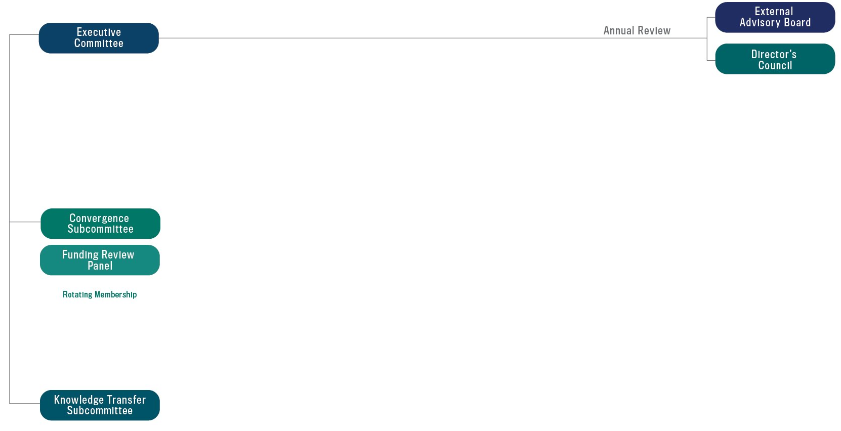
LEAP Governance Committees

Slide 21
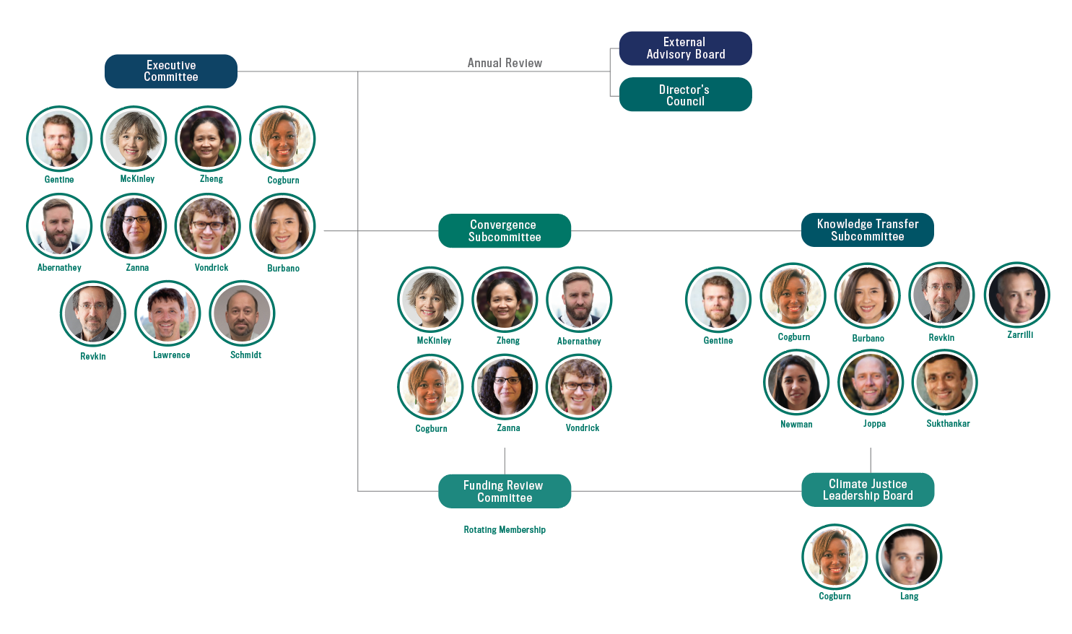
Executive Committee is the primary decision-making body
Membership
Responsibilities
  Strategic planning
  Distribution of funding
  Partnership stewardship
  Conflict resolution
Meets monthly
Equal voting
Chaired by Gentine
Staffed by Managing Director

Slide 22
LEAP Governance Committees

Slide 23
Convergence Subcommittee integrates Research + Education
Membership
Responsibilities
  Coordinates review of research and seed funding proposals
  Reviews research progress and sets research priorities
  Integrates research + education
  Plans Convergence Luncheons
Meets monthly
Co-chaired by McKinley + Zheng
Staffed by Managing Director

Slide 24

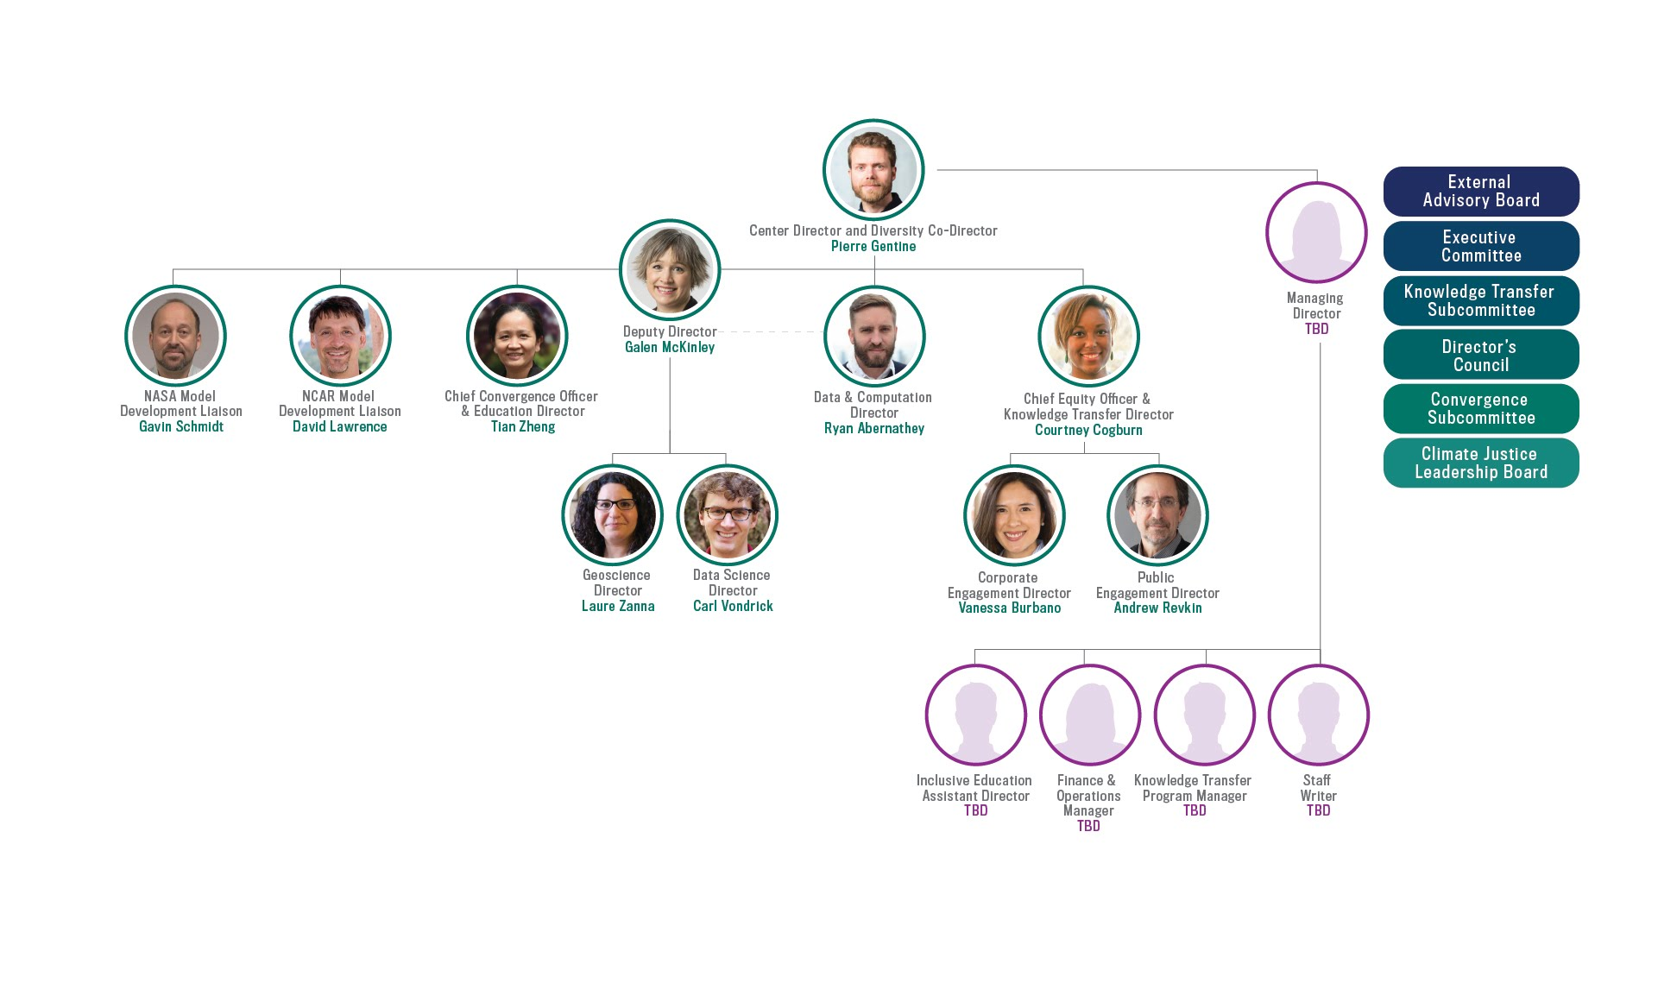
Formed annually, the Funding Review Panel will score proposed research
Membership
6 Senior Personnel from all LEAP institutions
  1 student + 1 postdoc
Co-chaired by member of Convergence Subcommittee
Responsibility
Rank proposed research + seed funding proposals
Meets every January
Staffed by Assistant Director
Membership drawn from full LEAP team
Changes annually

Slide 25
LEAP Governance Committees

Slide 26
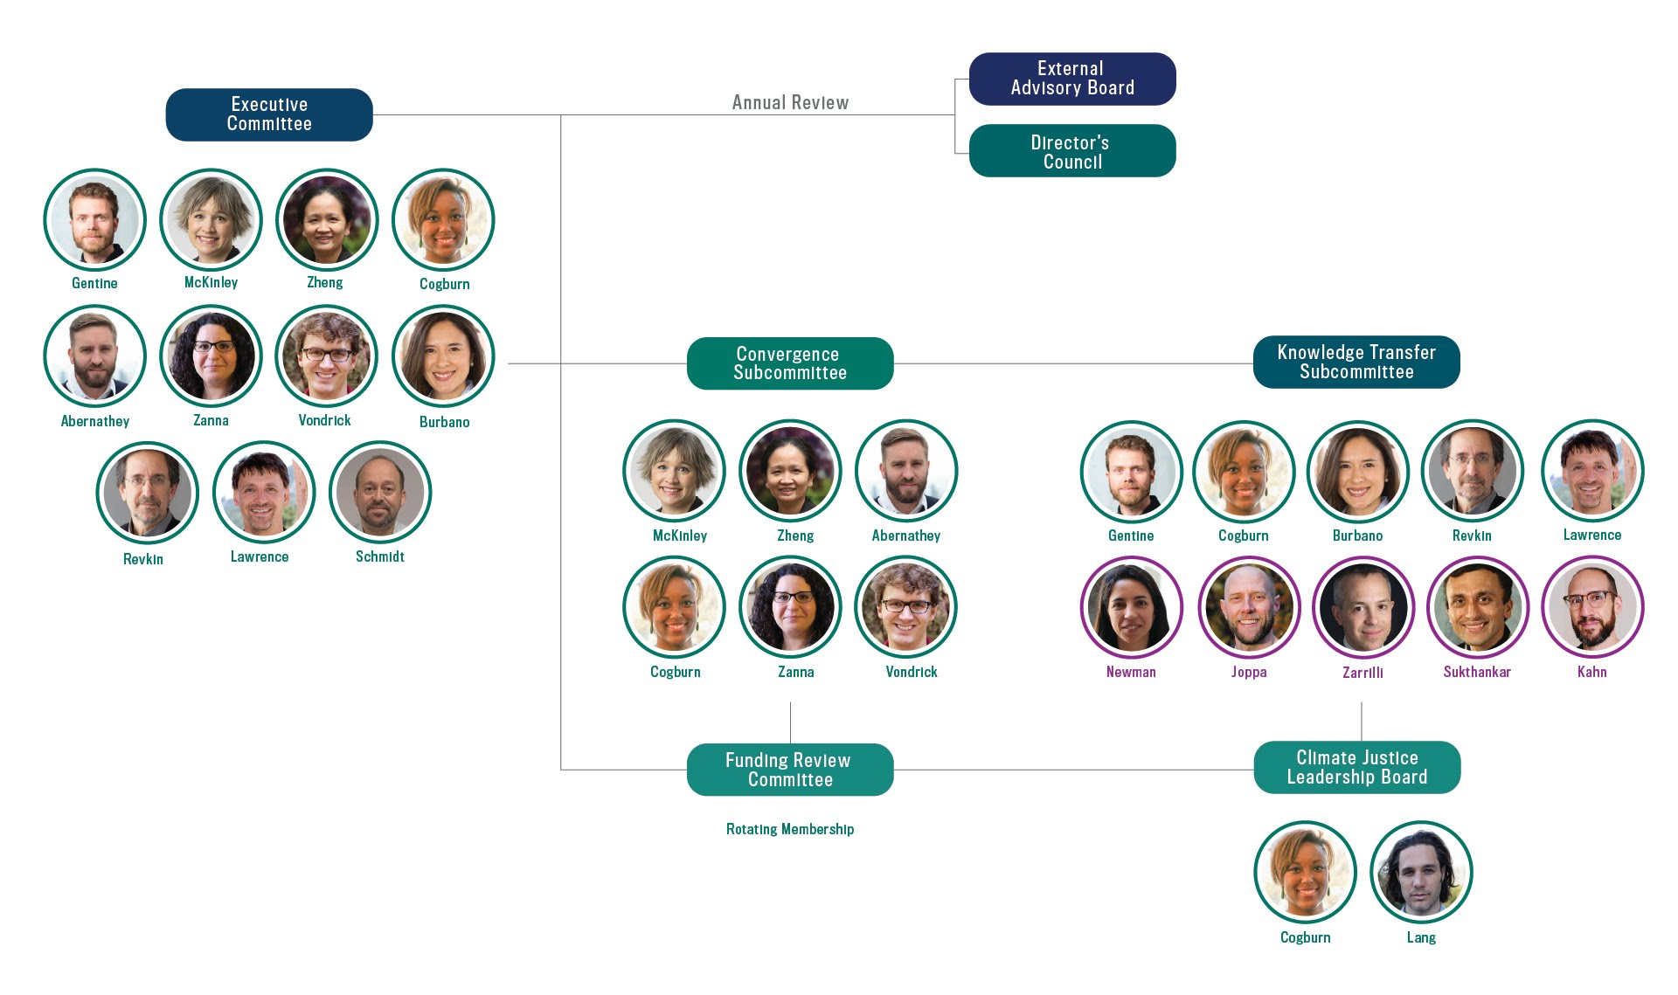
Knowledge Transfer Subcommittee drives DEI initiatives and engages stakeholders
Membership
Responsibilities
  Establishes bidirectional dialogue with stakeholders
  Governs Storytellers program
  Plans DEI day for annual meeting, Translate-a-thon, Hackathon
  Anonymization for hiring + proposal funding
Meets monthly
Chaired by Cogburn
Includes 5 corporate + public partners
Staffed by Knowledge Transfer
Program Manager

Slide 27
Director’s Council advises across academic institutions
Membership
6-8 executives across LEAP’s universities
Responsibilities
March meeting for preliminary Annual Report
Advises on institutional integration + removing barriers
Staffed by Gentine, McKinley +
Managing Director

Slide 28
External Advisory Board evaluates LEAP and provides strategic advice
Membership
6 senior researchers + leaders from
non-affiliate institutions
Selected by Executive Committee
Responsibilities
Reviews Annual Report in May
Advises on new partnerships, center strategy + sustainability
Staffed by Gentine, McKinley + Managing Director

Slide 29
Continued professional leadership development will support effective center management
LEAP Management Institute
LEAP Executive Committee in Year 1, 10 trainees per year thereafter
15 hours of courses on leadership + inclusive management
Executive Coaching
Gentine + McKinley, 1 hour/ month
Coach: Management Professor at Columbia Business School
Dean’s Mentorship Program
Monthly group meeting with Columbia Center Directors
Led by Columbia’s Engineering Dean
Provost Leadership Fellows
Two-year program for mid-career Columbia faculty
Insight into campus strategic initiatives, strategic planning + budget issues
Zheng finishes in 2021/ Gentine guaranteed spot in 2021-23

Slide 30

LEAP Staff will provide structured support
Managing Director
Reports to Gentine + McKinley
Staffs Executive Committee, Advisory Boards
Responsible for Financial Management, Reporting
Must Hold Grad Degree in LEAP-related Field
Employee of Columbia Engineering Dean’s Office
Demonstrated track record on DEI commitment

Slide 31
LEAP Staff will provide structured support
Managing Director
Inclusive Education Assistant Director
Implements education and broadening participation programming
Facilitates student + postdoc visitation to NCAR

Slide 32
LEAP Staff will provide structured support
Managing Director
Inclusive Education Assistant Director
Implements education and broadening participation programming
Facilitates student + postdoc visitation to NCAR
Finance + Operations Manager
Supports comprehensive financial management, reporting
Manages Center-wide human resources

Slide 33
LEAP Staff will provide structured support
Managing Director
Inclusive Education Assistant Director
Implements education and broadening participation programming
Facilitates student + postdoc visitation to NCAR
Finance + Operations Manager
Supports comprehensive financial management, reporting
Manages Center-wide human resources
Knowledge Transfer Program Manager
Builds + maintains website
Plans Convergence Luncheons + Public Conversations
Staffs Knowledge Transfer Subcommittee

Slide 34
LEAP Staff will provide structured support
Managing Director
Inclusive Education Assistant Director
Implements education and broadening participation programming
Facilitates student + postdoc visitation to NCAR
Finance + Operations Manager
Supports comprehensive financial management, reporting
Manages Center-wide human resources
Knowledge Transfer Program Manager
Builds + maintains website
Plans Convergence Luncheons + Public Conversations
Staffs Knowledge Transfer Subcommittee
Staff Writer
Develops articles and OpEds for corporate + public audiences
Plans Storytellers in Residence program
Primary point of contact for media
Staffs Knowledge Transfer Subcommittee

Slide 35
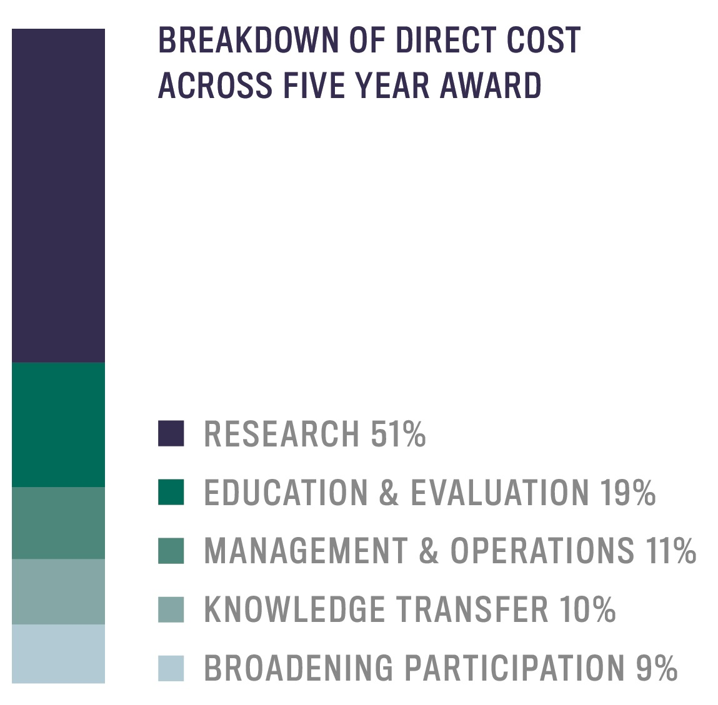
Budget reflects LEAP priorities
EDUCATION + EVALUATION 19%
KNOWLEDGE TRANSFER 10%
RESEARCH 51%
MANAGEMENT + OPERATIONS 11%
BROADENING PARTICIPATION 9%

Slide 36
Columbia Institutional commitments are substantial
Headquarters Space
Administrative Positions (2)
  Finance + Operations Manager
  Staff Writer
NCAR-Based Software Engineer (1)
Research Scientist (1)
“Bridge to PhD” Postbaccalaureate Trainees (3)
Storytellers in Residence (2)
Management Institute (1 per year)

Slide 37

Annual meetings allow for reflection, redirection + building Center culture
Kick-Off Meeting (Month 3)
Team building
Setting up goals and procedures (+ docs)
Subsequent Annual Meetings (August)
Day 1: Review of scientific progress
Day 2: DEI focused training + assessment
Day 3: Reflection + adjusting priorities

Slide 38


Documents support efficiency + transparency
Ethics Handbook
Expectations will be clearly stated
Example Topics
  Collaborative roles + responsibilities
  Authorship policies
  Mentorship expectations
Operations Manual
Standard procedures will be described in one place
Example Topics
  Annual funding allocation proposals
  Committee roles + responsibilities
  Staff roles + responsibilities
  Conflict resolution
Operational documents will be updated as needed + reviewed formally at annual meeting

Slide 39

Internal + external communication will be multi-faceted
Annual Report
Scientific progress
Education, proactive and integrative DEI initiatives + outcomes
Monthly Newsletter
Climate change indicators
Team highlights
Practical implications for stakeholders
Website
Research + education products
Event engagement opportunities
Communications supported by Knowledge Transfer Program Manager + Staff Writer

Slide 40
LEAP is prepared to address challenges as we enter uncharted territories
Research: Applicability of machine learning in CESM
Potential bottleneck: numerical instability + generalization
Solutions: experience with current parameterizations
+ eigenvalues + regularization + causality

Slide 41
LEAP is prepared to address challenges as we enter uncharted territories
Research: Applicability of machine learning in CESM
Potential bottlenecks: numerical instability + generalization
Solutions: experience with current parameterizations
+ eigenvalues + regularization + causality
Management
Potential bottleneck: conflicts from internal funding process
Solution: Seek best practices (CU seed funding)
+ define priorities + transparent funding review + reduced COI

Slide 42
LEAP is prepared to address challenges as we enter uncharted territories
Research: Applicability of machine learning in CESM
Potential bottlenecks: numerical instability + generalization
Solutions: experience with current parameterizations
+ eigenvalues + regularization + causality
Management
Potential bottleneck: conflicts from internal funding process
Solution: Seek best practices (CU seed funding)
+ define priorities + transparent funding review + reduce COI
Diversity
Potential bottleneck: limited diversity after a few (e.g. 2) years
Solution: increase collaboration with successful pipeline programs
+ expand reach in NYC’s diverse communities
+ partnership with NSBE (5 URM graduate/year)
+ SWOT analysis to reallocate funds

Slide 43

We are ready for this

Slide 44





We are ready for this
LEAP brings transformative impacts:
The proposal process has demonstrated we are a team:
  Collaboratively defined governance + priorities + funding
  Made hard decisions
  Created unique dialogue (climate + data science, broader impacts)
We are ready and uniquely positioned to execute our vision:
LEAP forward in the reliability, utility, and reach of climate projections through synergistic innovations in data science and climate science

Slide 45
Questions?

